Slide 1


Budgeting in the Municipal World
Presenter:
Melanie R. Walter

Slide 2
DLGS Role:
Promulgation of Standards
Oversight
Support
The Budget Process

Slide 3
Plan
Adjust
Act

Slide 4
BUDGET CALENDAR
Spring – Summer | Preliminary Estimates
Early Fall | Department Proposals
Late Fall | Management Review
January | Final Review and Recommendation
Budget Deadline | Local Budget Law
Transmission to governing body | January 15
Temporary Budget | January 30
Introduction and approval | February 10
Public hearing and adoption | March 20

Slide 5

MUNICIPAL BUDGET
Public Hearing
Preliminary Estimates
Department Proposals
Management Review
Final Review and Proposal
Governing Body

Slide 6
MUNICIPAL BUDGET
Public Hearing
Preliminary Estimates
Department Proposals
Management Review
Final Review and Proposal
Governing Body

Slide 7
MUNICIPAL BUDGET
Public Hearing
Preliminary Estimates
Department Proposals
Management Review
Final Review and Proposal
Governing Body

Slide 8
MUNICIPAL BUDGET
Public Hearing
Preliminary Estimates
Department Proposals
Management Review
Final Review and Proposal
Governing Body

Slide 9
MUNICIPAL BUDGET
Public Hearing
Preliminary Estimates
Department Proposals
Management Review
Final Review and Proposal
Governing Body

Slide 10
MUNICIPAL BUDGET
Public Hearing
Preliminary Estimates
Department Proposals
Management Review
Final Review and Proposal
Governing Body

Slide 11
MUNICIPAL BUDGET
Public Hearing
Preliminary Estimates
Department Proposals
Management Review
Final Review and Proposal
Governing Body

Slide 12
MUNICIPAL BUDGET
Public Hearing
Preliminary Estimates
Department Proposals
Management Review
Final Review and Proposal
Governing Body

Slide 13
Budgeting is a Continuous Process:
Planning
Preparation
Monitoring
The Budget Process

Slide 14
Planning
Identify Goals, Objectives, & Opportunities

Slide 15
Preparation
Gather Information:
Financial History
Revenues
Operations

Slide 16
Understand the General Cost of Services

Slide 17
Statutory and Regulatory Framework
DLGS Planning Resources
EGG Notices
Local Finance Notices
FAST Open Data Portal
The Cap Laws
Temporary Budget Laws

Slide 18
LAST YEAR’S BUDGET
(Less Public Assistance,
Debt Service and
Capital Improvement Fund)
THIS YEAR’S TEMPORARY BUDGET
- - - - - - - - - - - - - - -
Plus:
Public Assistance
Debt Service
Capital Improvement Fund
26.25%

Slide 19
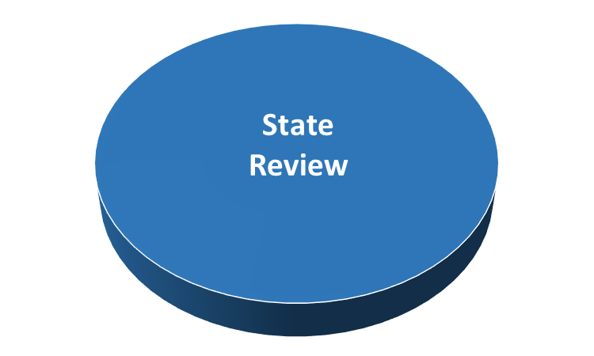
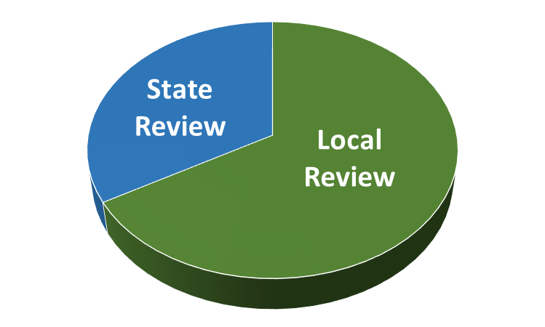
Outstanding Debt
Emergency Appropriations
Tax Collection Rate
Deferred Charges
Operating Deficit
DIVISION OF LOCAL GOVERNMENT SERVICES
Is the Municipality “fiscally sound”?
Procedural Deficiencies
Tax Sale
CAP Referendum
Transitional Aid
Does the municipality engage in any “non-standard” practices?

Slide 20
BUDGET CERTIFICATION
Revenue estimates are reasonable and accurate
Required appropriations are properly budgeted
Budget is within “CAPS”
All items are included and arranged according to the Local Budget Law
The budget has been properly introduced and advertised
Complies with Local Finance Board regulations

Slide 21
Monitoring
Benchmarks
Results and Outcomes
Adjustment
Periodic Review

Slide 22
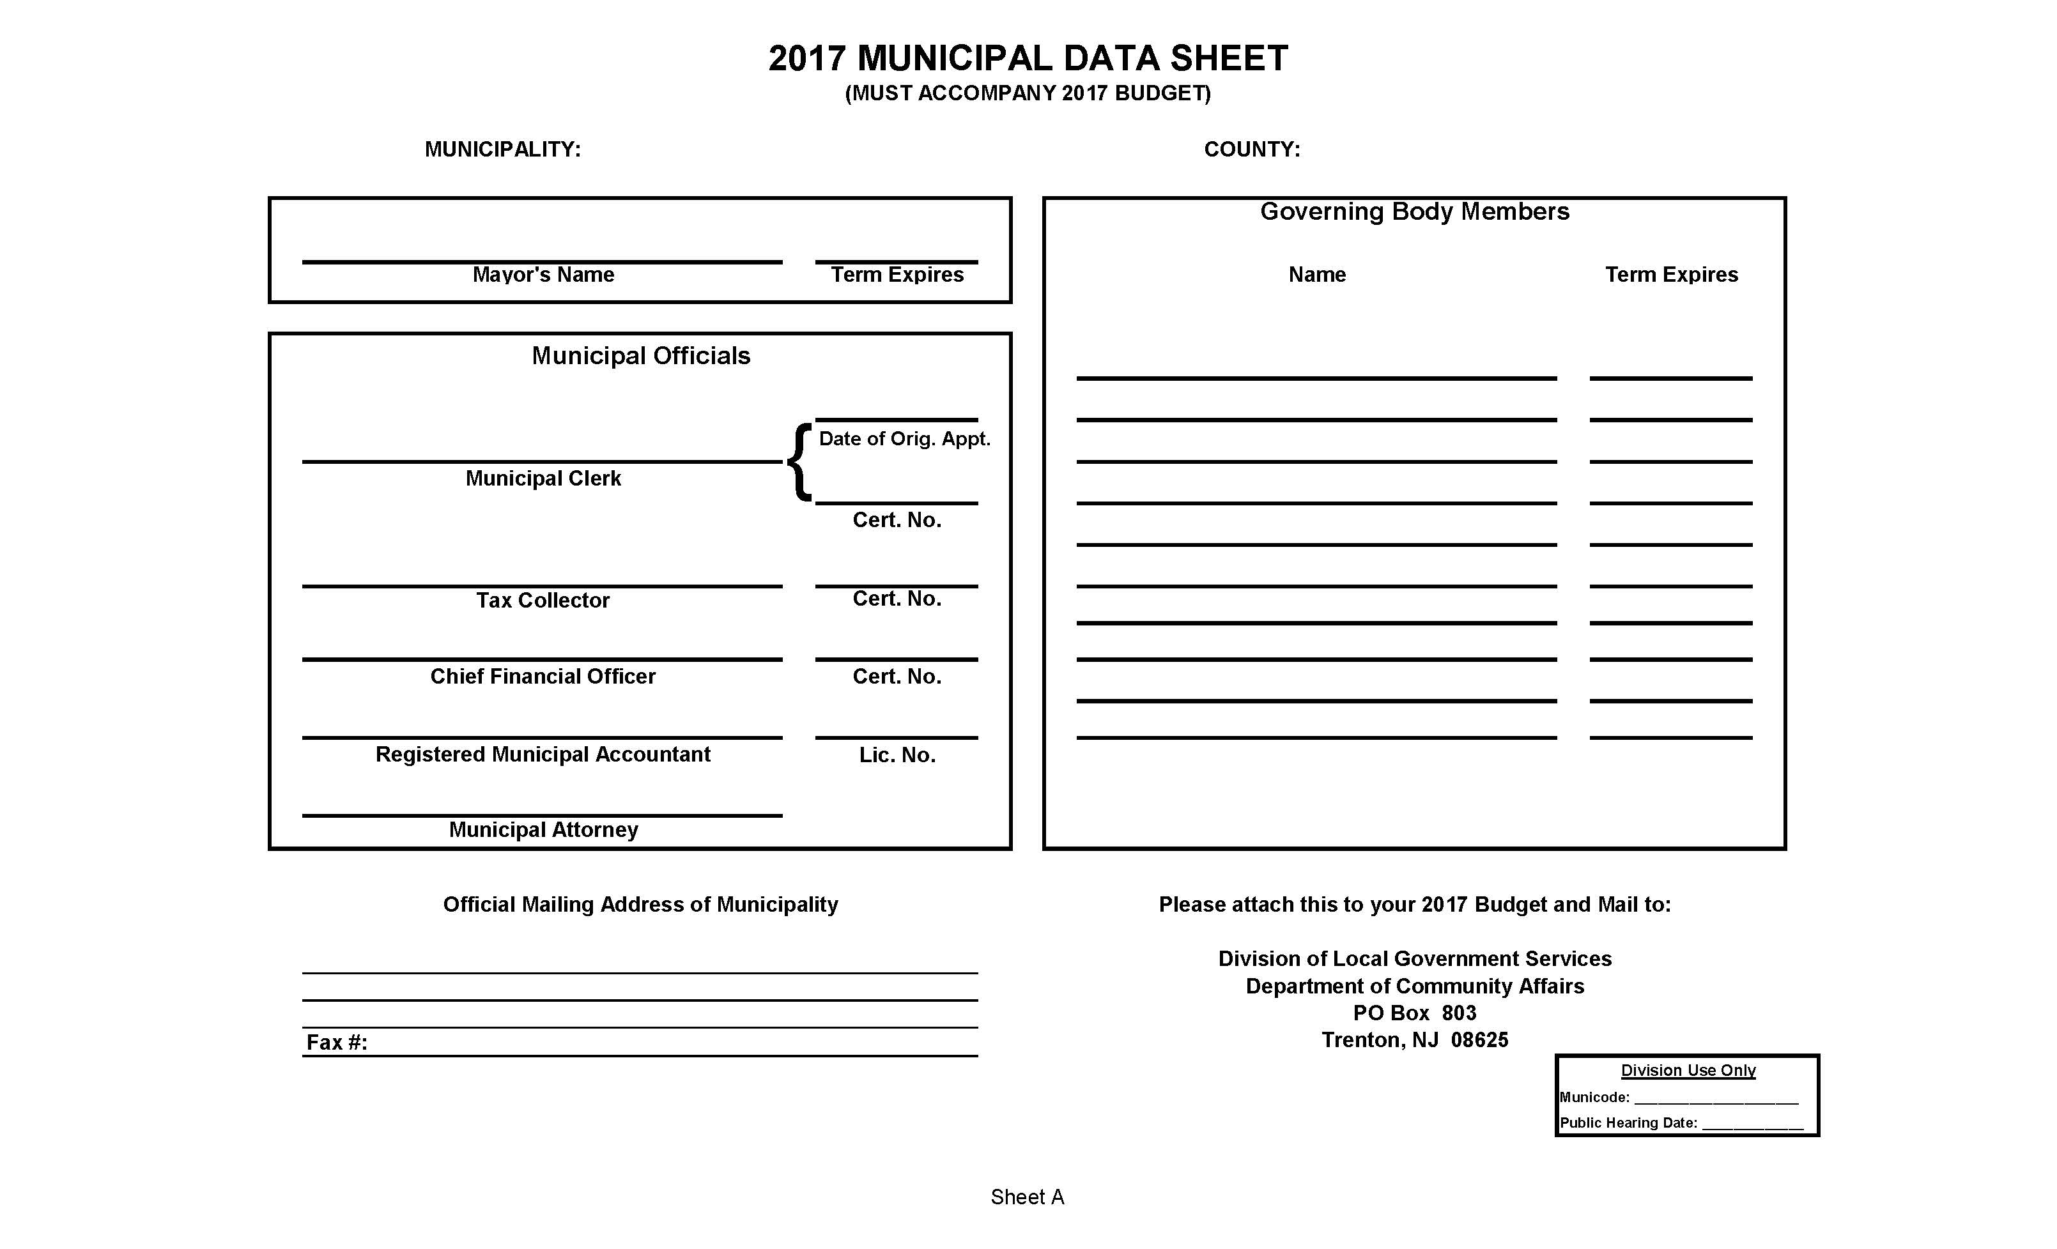

Slide 23
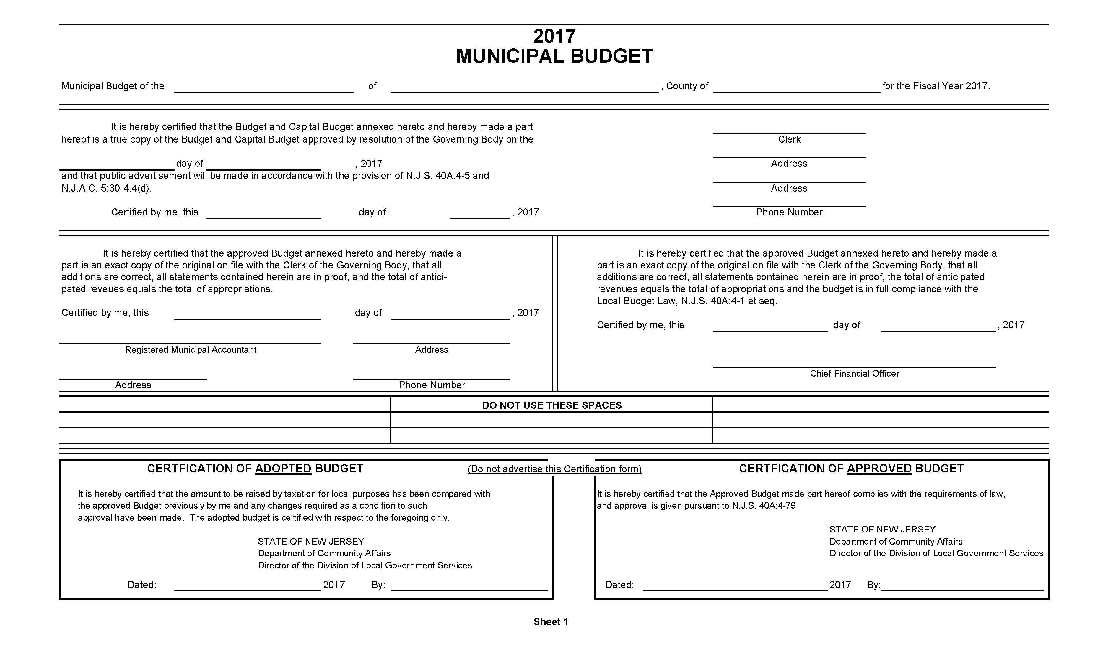

Slide 24
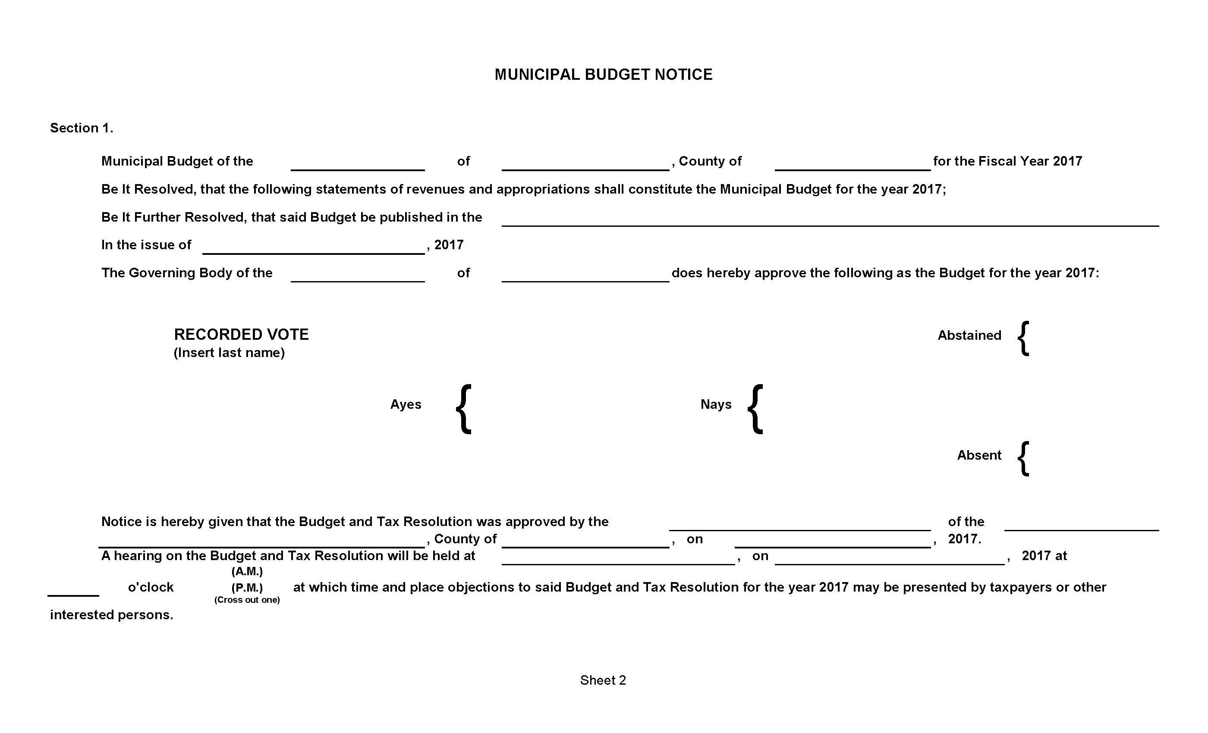

Slide 25
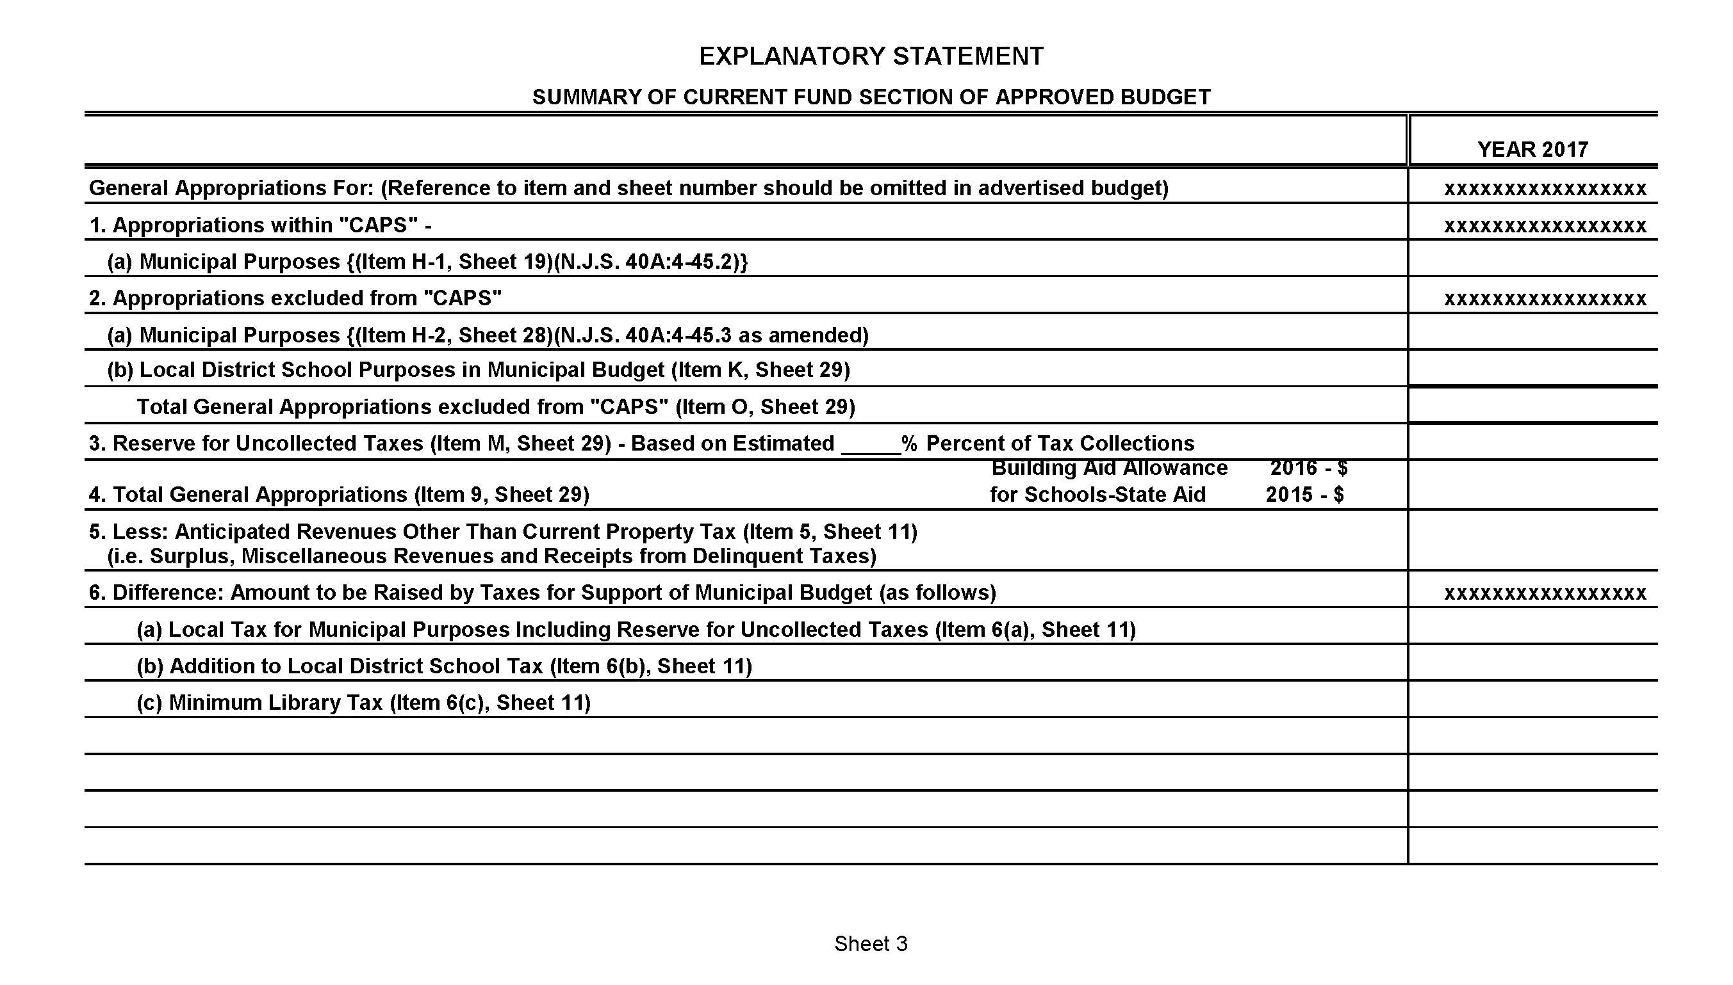

Slide 26
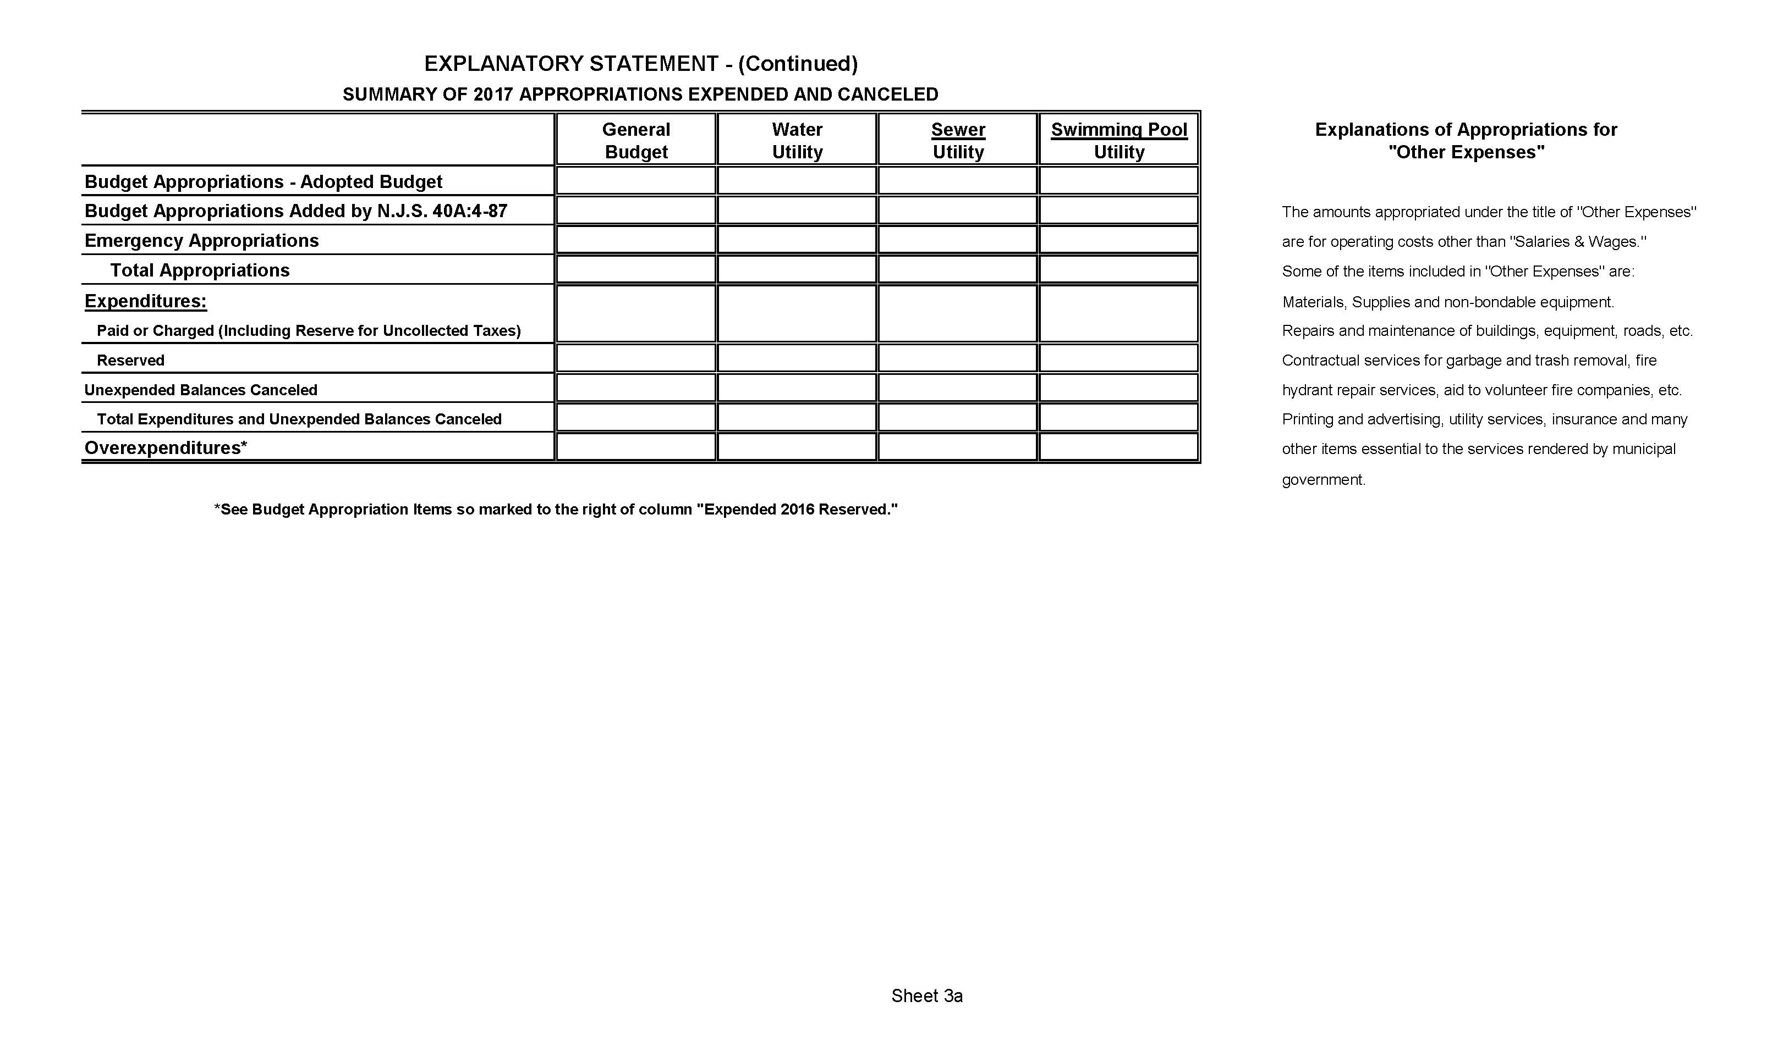

Slide 27
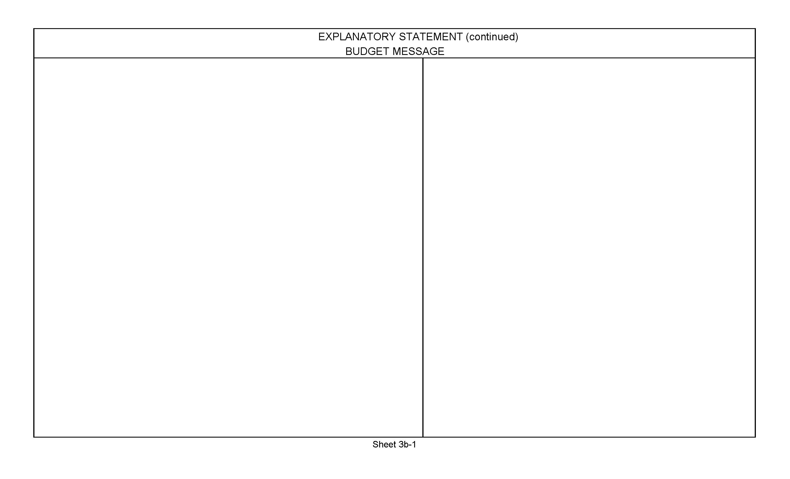
Estimated tax rate
Tax levy cap
Appropriations cap
Appropriations split between inside and outside the cap

Slide 28
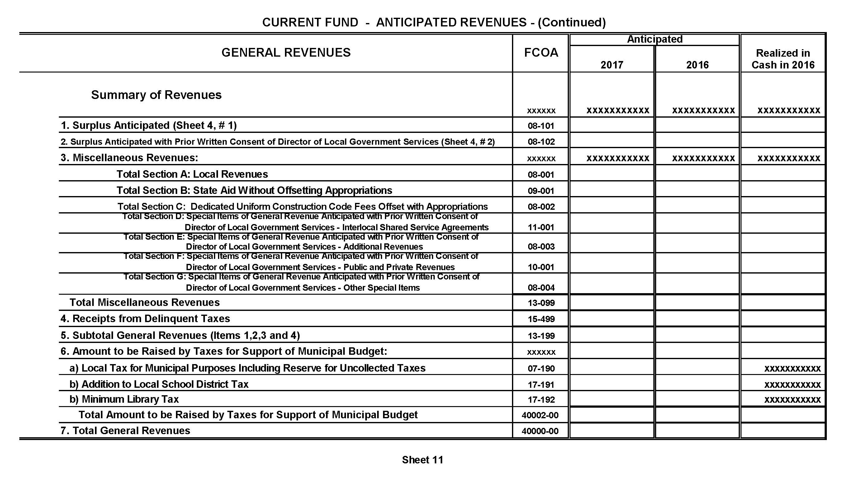

Slide 29
ACTUAL
REVENUE
COLLECTIONS
SURPLUS
BUDGETED
REVENUES
BUDGETED
APPROPRIATIONS
ACTUAL EXPENDITURES
SURPLUS

Slide 30
AUTHORIZED
SPENDING
BUDGETED
REVENUES
SAVINGS
SURPLUS

Slide 32
ABC Licenses
Other Licenses
Fees & Permits
Payments in Lieu of Taxes
Local Revenues
Construction Code Fees
Court Fines & Fees
Interest & Costs on Taxes
Hotel Tax
Interest on Investments
Franchise Fees
Sale of Recyclable Materials

Slide 33
Shared
Services
External Revenues
Public and Private
Revenues
State
Payments

Slide 35

Municipal Purposes
Local School District
Minimum Library Tax

Slide 36
2% CAP
LAST YEAR’S
TAX LEVY

Slide 37
INCREASES IN:
CAPITAL
DEBT SERVICE
PENSIONS
HEALTH BENEFITS
DEFERRED CHARGES
MAXIMUM PERMITTEED
TAX LVY
2% CAP
LAST YEAR’S
TAX LEVY

Slide 38
$60,000,000
Total Tax Levy
$3,000,000,000
Total Assessments
$2,000,000,000
Total Assessments
$2.00 per $100 value
=
$60,000,000
Total Tax Levy
$3.00 per $100 value
=

Slide 39
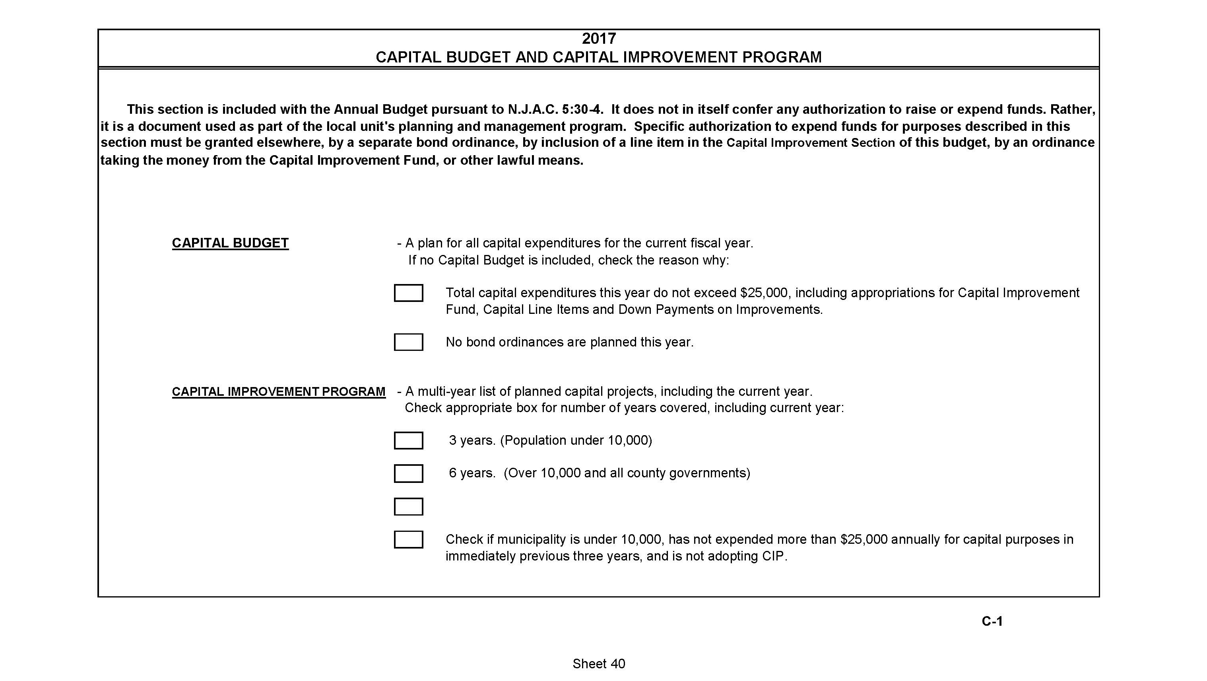

Slide 40
Debt
A four-letter word?
Not always.
Proceed with Care.

Slide 41
Final Food for Thought
Look for Easy Wins.
Consider Shared Services.
Cover your Costs.
Explore Refundings for Savings.
Shop Around.
Know your Cost Drivers.
Be Realistic.

Slide 42
Thank you!

