Slide 1
Lunch & Learn: Lame Duck
October 31, 2025
Mike Cerra, Executive Director
Lori Buckelew, Deputy Executive Director
Paul Penna, Director of Government Affairs
Erin Knoedler, Legislative Analyst
Sadayah DuRant-Brown, Legislative Counsel

Slide 2
Lame Duck Overview
Election Day is just 4 days away!
What changes we may see during Lame Duck?
  Energy Tax Receipt Changes
  Land Use Legislation
  State Health Benefits Program
  Business Personal Property Tax

Slide 3
What is Lame Duck?
The 221st NJ Legislative Session ends Jan. 13, 2026
Lame Duck occurs following the general election in mid-November through mid-January
End of session, the Governor:
  No longer has the option of returning a bill to the Legislature via a conditional veto.
  Has 7 days (12 noon, January 21) to either sign legislation or veto it.
Any bill not signed into law after 10 days does not become law (Pocket Veto).
Bill dies at end of legislative term; process starts all over.
Senate Committees schedules for Nov. 10.

Slide 4
State Health Benefits

Slide 5
State Health Benefits Program Updates
Over the past 4 years, those who participate in the SHBP Local Government Employer Group have seen a drastic increase in health insurance costs.
Prior year increases include
  16.4% in Plan Year 2025,
  7.4% in Plan Year 2024, and
  20% in Plan Year 2023.
In September, the State Health Benefits Commission (SHBC) approved a 36.25% increase for Local Government Employer Group Plan Year 2026.

Slide 6
SHBP Updates
Plan Year 2026 renewal rate for local governments is 36.25% as recommended by AON
Does not include
  fully funding the $200 million borrowed to date under c. 66 (law that allowed SHBP to loan funds to SHBP Local Government to meet cash flow)
  Funds to bring the Claims Stabilization Reserve up to the required two-month balance.

Slide 7
SHBP Updates
FY26 State Budget included language that required both the State members and Public Employee members of the Plan Design Committee (PDC) to submit proposals to AON to achieve $100 million in recurring savings during the first six months of the plan year 2026.

Slide 8
SHBP Updates
Governor Murphy & the 17 public sector unions representing State workers have announced an agreement designed to achieve approximately $75 million in recurring health benefit savings for the final six months of FY 2026.
This agreement does not include local governments in the SHBP
Represents a short-term remedy.
Anticipate legislation to apply these savings to the Local Employer Group

Slide 9
SHBP Updates
The Memorandum of Agreement includes:
A $110 in-network deductible for individuals and $220 in-network deductible for families for all plans that currently have lower deductibles.
A $750 out-of-network deductible for individuals and $1,500 out-of-network deductible for families for all plans that currently have lower deductibles.
A $2,500 out-of-network, out-of-pocket maximum for individuals and $6,000 out-of-network, out-of-pocket maximum for families for all plans that currently have lower out-of-network, out-of-pocket maximums.
New co-pays on GLP-1, generic, brand, non-preferred brand, and specialty medications across all plans.
New co-pays on lab visits and imaging across all plans.
Incentivizing use of in-network ambulatory surgical centers for certain procedures across all plans.
Limits on out-of-network physical therapy visits across all plans.
Expansion of the forthcoming Centers of Excellence pilot program for all plans.

Slide 10
SHBP Updates
The State has also agreed to continue to work with the unions on identifying longer-term, significant cost containment strategies.
Item number 10 of the Memorandum of Agreement states that due to the cost savings agreed to by the unions, no escalator will be applied to the members’ contributions to the cost benefits for plan year 2026.

Slide 11
SHBP Updates
What’s next?
  Since the end of 2020,
    more than 90 local governments, representing more than 10% of participating local governments, have left the SHBP,
    choosing to obtain coverage for their employees from a Health Insurance Fund (HIF) or the private market.
  While the MOA does not include local governments, & only represents a short-term remedy, the League hopes that this agreement will influence discussions for the SHBP Local Government Employee Group.
  It is likely that additional legislation will be required to apply any savings to the Local Employer Group and avoid bargaining with local units.

Slide 12
Land use legislation

Slide 13
Land Use Legislation
Land Use Preemption Bills
  S-1408/A-2757 - "Stranded Assets"
  S-4451/A-5667 – Land Use Element to be part of the Master Plan
  S-2347/A-2792/4370/2489 (ACS) Concerns development of Accessory Dwelling Units (ADUs)
  S-2974/A-3043 - Reduces parking spaces required in statewide site improvement standards at residential development relative to proximity to public transportation
  S-4048/A-5241 – Warehouse Prohibition Near Historic District
  S-4736 Enhances ability of religious and nonprofit organizations to convert certain property to inclusionary developments with affordable housing.

Slide 14
S-1408/A-2757 "Stranded Assets"
Reported out of Senate Urban & Community Affairs Committee on March 17; 2nd reading in the Senate.
Requires a municipal planning board to permit the conversion of eligible properties, so-called “stranded assets” into mixed-use developments, effectively bypassing the existing variance procedure and preempting local zoning.
An eligible property is defined as:
  An office park that is at least 50,000 square feet or a retail center of at least 15,000 square feet;
  Has a vacancy rate of at least 25% rate for a continuous18 months immediately preceding the application; or
  Has suffered an economic downturn over the immediately preceding 3 years, demonstrated by evidence of a quantifiable loss in revenue such that the developer’s expenses for the premises have exceeded revenues by at least 30% or more each year; and
  Owner of the property has made & maintained a continuous good faith effort to redress the vacancy, actively rent, or actively market the property for the 18 months immediately preceding application.

Slide 15
S-1408 "Stranded Assets" Continued
Mixed Use Development application: At least 20% of the residential units to be constructed shall be reserved as very-low-income housing, low-income housing, or moderate-income housing
    At least 50% within each bedroom distribution are low-income limits
    At least 13% are very low income units
Establishes criteria to follow for multiple mixed-use zones and legislates mixed-use zones if the municipality does not have a mixed-use zone. This may result in litigation.
Project must be eligible for PILOT Agreement and deemed an “area in need of redevelopment” or “area in need of rehabilitation” without consideration of Local Redevelopment & Housing Law
In legislative findings include:
  “one significant impediment to converting stranded retail centers and office parks into dynamic mixed-use communities is the application of outdated, rigid municipal zoning regulations that often separate residential and commercial uses from each other.”
  “to encourage the development of vibrant and desirable mixed-use communities, further to the public good, it is appropriate for the Legislature to set standards to modernize local land use regulations that stand in the way of the repurposing and redevelopment of stranded retail centers and office parks.”
The League testified in opposition to the legislation based on the unnecessary and unwarranted preemption of local master planning.
Any such application can be made through the variance process or a redevelopment process.
The criteria in the bill is ripe for litigation and expressed concern that this could turn into a backdoor means to challenge a town’s approved affordable housing plan and expose the municipality to litigation.
A-2757, which has not been amended to match the Senate version, has been referenced to Assembly Commerce, Economic Development and Agriculture Committee

Slide 16
S-4451 Land Use Element in Master Plan
Passed Senate 23-14; Received in Assembly & referred to Assembly Housing Committee
Modifies requirements for land use plan element and housing plan element of the master plan.
The housing plan element would be required as part of the municipal master plan – immediately
The League raised several concerns with the sponsor because the bill is effective immediately. Potentially current master plans could be deemed non-compliant requiring immediate revisions.
It will require the expenditure of significant resources to have the appropriate professionals go out into the municipalities to assess the current plans and changes that will need to be made, as well as to create further plans regarding, for example, transportation and access.

Slide 17
S-2347/A-2792/4370/2489 (ACS) Concerns development of Accessory Dwelling Units (ADUs)
The legislation would prohibit municipalities from restricting the development of ADUs and establish the criteria for such development. ADUs will be permitted as a right if the ADU is used or intended to be used by the property owner, family members, or non-paying guests.
Within 90 days of the bill’s enactment municipalities would be required to adopt an ordinance incorporating the provisions of the bill. The ordinance must provide that:
  An ADU may only be developed on a lot upon which a single-family dwelling or two-family dwelling is a permitted use, unless the applicable municipal zoning ordinance permits development of an accessory dwelling unit at other locations.
  An ADU must contain at least 300 square feet of complete independent living facilities per unit.
  The height of a proposed ADU must not exceed the height of the primary dwelling.
  An ADU shall not be located closer than five feet from the lot line.
  An ADU may provide direct exterior access that is separate from the direct exterior access for the primary dwelling.
  Additional off-street parking for an ADU shall not be required; and
  The installation of fire sprinklers shall not be required in an ADU that is within, or an extension to, a preexisting primary dwelling that is not required to install fire sprinklers.

Slide 18
S-2347/A-2792/4370/2489 (ACS) Concerns development of Accessory Dwelling Units (ADUs) - Continued
A municipal land use ordinance may include one or more of the following provisions:
  Reasonable landscaping standards for detached accessory dwelling units.
  Architectural review requirements for an application for development of an ADU within an area designated as a historic district, if the development requires either new construction or exterior modification of an existing structure.
  An ADU shall not be rented for a period of less than 30 days and may include penalties that may be imposed upon the owner of an ADU that violates this paragraph.
  An ADU is a permitted use in addition to those types of zoning districts identified in the bill; or
  The maximum size of an ADU that is constructed separately from a primary dwelling shall be limited to square footage that is not in excess of 60% of the lot’s buildable area.
  At its February meeting, the Assembly Housing Committee considered three bills that would preempt local planning and permit the development of Accessory Dwelling Units (ADUs) on property zoned for single or two-family residential uses. The committee merged the three bills into ACS for A-2792, A-4370, and A-2489; however, they did not advance the legislation.
The Senate companion bill, SCS for S-2347 and S-1106 was reported out of Senate Community and Urban Affairs Committee on February 15. It was amended and substituted on the Senate floor February 25.

Slide 19
S-2974/A-3043 Parking Requirements
Reported out of Senate Community & Urban Affairs Committee; 2nd reading in Senate
Reduces the number of parking spaces required in Statewide site improvement standards at residential developments relative to the development’s proximity to public transportation.
Requires the DCA Commissioner to adopt regulations implementing certain reductions in the maximum required for on- and off-street parking spaces in the Statewide site improvement standards
Eliminate off-street parking requirements within ½ mile of any rail passenger service station
50% reduction in required parking spaces within ½ mile of Public transportation service; 5 or more regular bus routes; or Roadway with at least 15 roadside regular bus stops
30% reduction in required parking spaces within ½ mile & 1 mile of same
Restricts a municipality’s ability to make land use decisions that best suit its community and that are reflected in their Master Plan.
A-3043 referred to Assembly State & Local Government Committee

Slide 20
S-4048/A-5241 – Warehouse Prohibition Near Historic District
Reported out of committee; 2nd reading in Senate
Prohibits approval of project related permit for the construction of a large warehouse development on land within 1000 feet of a historic district
A planning board within jurisdiction over a historic district, may waive the prohibition if a developer petitions the planning board for a wavier
As amended S-4048 narrowly defines a historic district and grants waiver authority to the Planning Board where the historic district is located.
Under the definition of historic district, this legislation applies to approximately eight locations throughout the state.
However, in one instance, the historic district is in a neighboring municipality from the proposed development and grants land use authority to the neighboring municipality where there is no responsibility or accountability to the residents of the developing municipality.
There are several concerns with the legislation primarily because it violates the long-held tenet of home rule where municipalities make decisions for their communities and stand accountable to their residents.
A-5241 referred to Assembly State & Local Government Committee

Slide 21
S-4736 - Enhances ability of religious and nonprofit organizations to convert certain property to inclusionary developments with affordable housing.
Introduced & referred to Senate Community & Urban Affairs Committee
Enhances ability of religious and nonprofit organizations to convert certain property to inclusionary developments with affordable housing.
Requires a municipal planning board to permit the conversion or partial conversion of an eligible property, as defined in the bill, into an inclusionary development, for which a certain percentage of the units are reserved as very low-, low-, or moderate-income housing (affordable housing).
The conversion of an eligible property into an inclusionary development with affordable housing would be a permitted use and would not require a use variance, and would be subject to certain zoning requirements and the following affordability constraints:
  at least 20% of the units are required to be reserved as very-low, low-, or moderate-income housing;
  of the income-restricted units, at least 50% within each bedroom distribution are required to be low-income units, and at least 13% of the low-income units as very-low-income units; and
  the income-restricted units are required to comply with the State’s Uniform Housing Affordability Controls.
The bill requires a municipal planning board to approve an application to repurpose or redevelop an eligible property into an inclusionary development with affordable housing, regardless of the eligible property’s location in the municipality if the project complies with applicable zoning requirements, as described in the bill. The bill specifies certain permitted density and height criteria.

Slide 22
S-4736 Continued
Regardless of any provision of the "Long Term Tax Exemption Law," P.L.1991 (C.40A:20-1 et seq.) to the contrary, the bill specifies that a project undertaken pursuant to the bill is to be eligible for long term tax exemption pursuant to the "Long Term Tax Exemption Law."
The "Long Term Tax Exemption Law" permits a municipality to enter into financial agreements with urban renewal entities, which agreements require an entity to make payments in lieu of real property taxes pertaining to the improvements constructed on the property.
The provisions of the bill are not to prohibit or limit an applicant’s ability to apply and qualify for variances, tax incentives, financing, or grants.
A development project and any municipal action undertaken pursuant to the bill is to be in compliance with the "Municipal Land Use Law," P.L.1975, c.291 (C.40:55D-1 et seq.) and all other applicable municipal zoning ordinance requirements that do not conflict with the bill.

Slide 23
Energy tax receipts

Slide 24
Energy Tax Receipts (ETR)
S-4691/A-5787 was introduced at the end of June and has yet to have a hearing.
It repeals sections of law providing for the distribution Energy Tax Receipts Property Tax Relief and Consolidated Municipal Property Tax Relief Aid.
Replaces the Energy Tax Receipts Property Tax Relief Aid program with a new initiative, the “Municipal Property Tax Relief Program.”
Requires State revenues currently deposited into the Energy Tax Relief Property Tax Relief Fund to be deposited into the Municipal Property Tax Relief Fund and dedicates those revenues to support State aid payments to municipalities under the new program.

Slide 25
S-4691/A-5787 – ETR
Starting SFY26 following funds credited to "Municipal Property Tax Relief Aid Fund" net payments from:
  Sales & use of energy or utility services under Sales & Use Tax Act
  Payments under the Corporate Business Tax (CBT) from gas, electric, and gas & electric public utilities
  Payments under the CBT from telecommunications public utilities as of April 1, 1997
  Payments from sewerage & water corporations under the Transitional Energy Facility Assessment Act
  Sums from the General Fund or Property Tax Relief Fund as necessary to provide that the annual amount credit to the fund shall equal the amount determined by this law

Slide 26
S-4691/A-5787 – ETR
Each municipality shall receive an amount not less than the amount received by the municipality from the distribution of the ETR in CY2024 or SFY2025 for a municipality that utilizes a state fiscal year budget cycle.
Funds distributed annually as follows:
  On or before August 1 – 45% of the total amount due
  September 1 – 30% of the total amount
  October 1 – 15% of the total amount
  November 1 – 5% of the total amount
  December 1 – 5% of the total amount for calendar year municipalities and June 1 for state fiscal year municipalities
DLGS Director can accelerate payments if necessary to ensure fiscal stability of municipality
SFY2026 $1,455,000,000 multiplied by the greater of the sum of 1.0 or the index rate and be credited to the "Municipal Property Tax Relief Fund"

Slide 27
S-4691/A-5787 – ETR
No municipality shall receive less than the amount received in ETR in CY 2024 or SFY2025 for state fiscal year municipalities
Distribution based on formula developed by DCA Commissioner that must include:
  population according to the most recent federal decennial census;
  median household income according to the most recent estimate by the United States Bureau of the Census;
  equalized property valuation per capita;
  the ratio of the average equalized value of residential property in the municipality to the average equalized value of residential property Statewide ;
  the value of State property that is exempt from ad valorem taxation as a percentage of the total value of property in a municipality;
  the ratio of assessed value to true value of real property of the municipality, as published in the table of equalized valuations by the Division of Taxation Director pursuant to N.J.S.A. 54:1-35.1, in relation to a minimum ratio of 85%;
  the level of distress experienced by a municipality as measured by the Municipal Revitalization Index established by the Department of Community Affairs; and
  a spending restraint factor calculated as the difference between estimated and actual spending, based on criteria established by the Commissioner of Community Affairs that predict such spending.

Slide 28
S-4691/A-5787 – ETR
Within two days of budget transmission DLGS Director must notify each municipality of the amount of Municipal Property Tax Relief Aid payable to the municipality in the succeeding fiscal year
Excess aid must be used solely & exclusively to reduce the amount required to be raised by local property tax levy for municipal purpose
    Any amount of aid distributed from the Municipal Property Tax Relief Aid fund in excess of the amount distributed from ETR during SFY 2002
If in any fiscal year the State receives more than $1,425,000,000 from taxes dedicated for the Municipal Property Tax Relief Fund Act then 75% of the amount must be credited to the Municipal Property Tax Relief Aid Fund for distribution to municipalities as additional aid
Includes a poison pill

Slide 29
Business personal property tax

Slide 30
Business Personal Property Tax (BPPT)
Business Personal Property Tax (BPPT) was enacted in 1997 as New Jersey’s response to laws enacted at the federal level.
Telephone exchanges operating 51% or greater within a municipality are required to pay BPPT to the municipality, the definition of how these calculations should be made.
As a result, it has been challenged and resulted in costly litigation for Hopewell Borough.
Absent legislation to clarify this tax, every municipality faces the prospect of costly annual tax court filings (i.e.Verizon v. Hopewell).
Currently, there is a minimum of 127 other municipalities in the position of Hopewell Borough, and well over 60 pending trials.
The New Jersey Supreme Court affirmed an Appellate Division decision and Hopewell was successful, municipalities still settle individually for each tax year.

Slide 31
BPPT – S-1535
S-1535 was introduced to revise the definition of “local exchange telephone company” to mean a telecommunications carrier which held the regional monopoly on landline service before the market was opened to competitive local exchange carriers by the federal Telecommunications Act of 1996, or the corporate successors of such a local exchange telephone company.
It will require that the dominant telecommunications carrier in each region to pay the BPPT on its business personal property regardless of the percentage of a local telephone exchange and will permanently preserve that business personal property into the tax base.
The bill also requires that if a municipality is the prevailing party in a court proceeding between it and a local exchange telephone company regarding this matter, they be awarded attorney’s fees as costs to the local exchange telephone company.

Slide 32
And don't forget...
DEP Resilient Environments & Landscapes (REAL) Rules
Dupont/3M PFAS Contamination Settlement
Uniform Housing Affordability Controls (UHAC)

Slide 33

Quick Promotion
News Flashes – www.njlm.org/NewsFlashes
Join us at the 110th Annual Conference

Slide 34
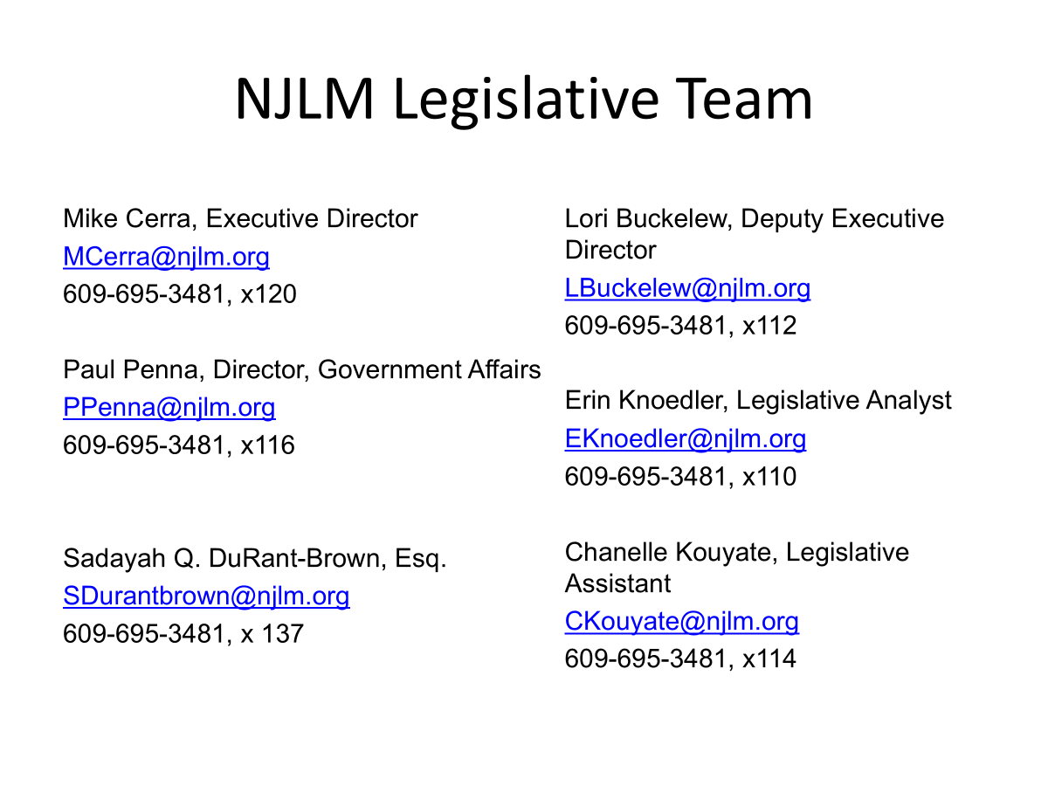
Questions, Comments, Concerns?

Slide 35

HAPPY HALLOWEEN!!!!

