Slide 1
Lunch & Learn NJDEP Resilient Environments and Landscapes (REAL) Rule
Presented: October 3, 2024

Slide 2


150 Clove Road, 9th Floor, Little Falls, NJ 07424
NJDEP Proposed Resilient Environments & Landscapes (REAL) Rule
John M. Scagnelli, Esq.
Date: October 3, 2024

Slide 3
NJDEP REAL Rule Proposal
The New Jersey Department of Environmental Protection has issued a proposed Resilient Environments and Landscapes (REAL) rule. The REAL rule is part of Governor Murphy’s Protecting Against Climate Threats (PACT) Initiative, as directed by Executive Order No. 100 (January 2020). NJDEP’s proposed rule includes amendments to the Coastal Zone Management Rules, N.J.A.C. 7:7-1 et seq, Freshwater Wetlands Protection Act Rules, N.J.A.C. 7:7A-1.1 et seq., Flood Hazard Area Control Act Rules, N.J.A.C. 7:13-1.1 et seq., and Stormwater Management Rules, N.J.A.C. 7:8 -1 et seq.
The proposed REAL rule was published in the New Jersey Register and virtual public hearings are ongoing. NJDEP does not expect to adopt the REAL rule until July 2025.
NJDEP’s proposed REAL rule is based upon increased precipitation and sea level rise predictions specific to New Jersey. NJDEP’s 2023 Inland Flood Protection Rules focused on current and future precipitation increases and their effects on fluvial areas and stormwater management. NJDEP’s changes to the Stormwater Rules at N.J.A.C. 7:8 addressed climate change concerns relating to storm water management.

Slide 4
Key Points of NJDEP’s REAL Rule
Adjust Coastal Flood Hazard Areas for projected rising sea levels and storm surge, extend the flood hazard area further inland, require higher first-floor elevations or floodproofing for buildings and higher roadways;
Create an Inundation Risk Zone (IRZ) to address risk for residential building and critical structures in areas of permanent or daily inundation due to sea level rise;
Add sound stormwater management practices to improve water quality and reduce flooding;
Encourage nature-based solutions to protect communities and resources;
Support renewable energy by balancing habitat conservation with novel infrastructure demands;
Improve State alignment with FEMA's National Flood Insurance Program (NFIP); and
Improve NJDEP permitting processes to better track authorizations and permits from start of project construction to completion.

Slide 5
Rulemaking Principles in Developing the REAL Rule
Increase protection against future flood inundation and damage from sea level rise and extreme storm events;
Protect critical facilities and infrastructure from the effects of climate change;
Restore water quality and reduce flooding, especially in urbanized areas;
Increase resilience of land and water resources;
Plan for climate change;
Design using nature-based solutions;
Encourage renewable energy; and
Improve the administrative process.

Slide 6
NJDEP Principle No. 1. - Increase Protection Against Future Flood Inundation And Damage From Sea Level Rise and Extreme Storm Events
Create an Inundation Risk Zone (IRZ) in Tidal Flood Hazard Areas. The IRZ is a portion of a tidal flood hazard area determined to be at significant risk for future permanent or daily inundation. Standards are proposed for new or improved residential buildings, critical buildings, and critical infrastructure within the IRZ to account for increased flood risk due to expected sea level rise and more intense storm events.
An Inundation Risk Assessment examining potential injury, damage and costs of inundation is required. An applicant for a residential project must do an on-site alternatives analysis to show its efforts to avoid or minimize risks. This analysis is not required if the project involves repairs or maintenance which does not change the building height, footprint or habitable area.

Slide 7
NJDEP Principle No. 1. (cont.)
An Inundation Risk Zone applicant must show:
1. Mean higher high water elevation at the nearest site;
2. Minimum amount of inundation which would cause the lowest portion of the site to be inundated on a regular basis and the maximum depth of inundation;
3. Where the project involves construction of or improvements to a building, the minimum amounts of inundation which would cause the lowest portion of the primary roadway providing regular or emergent access to be inundated daily and the maximum depth of inundation on the roadway.
4. Efforts to mitigate, including altering topography and changing the project configuration.

Slide 8
NJDEP Principle No. 1. (cont.)
NJDEP states that 94% of the Inundation Risk Zone (IRZ) is already developed, and that most of these projects will involve redevelopment.
NJDEP’s REAL rule redefines the extent of tidal flood hazard areas and replaces the existing “flood hazard area design flood elevation” with a proposed “climate adjusted flood elevation” (“CAFÉ”). The proposed CAFE is calculated by adding FIVE feet to FEMA's 100 year flood elevation in tidal flood hazard areas PLUS ONE FOOT of freeboard.
For example, for a residential project, if the preliminary FEMA flood elevation is 11, then you must add 5 feet, equaling 16 feet, then 1 foot of free board, so that the first floor elevation would need to be at 17.
For commercial development, the building can be elevated or flood proofed or both. Habitable floors must be dry floodproofed but non-habitable floors can be wet floodproofed.

Slide 9
NJDEP Principle No. 1. (cont.)
NJDEP’s REAL rule does not address the height variance issue where the developer is squeezed between the higher first floor elevation and the maximum height of the building permitted by local ordinance. The existing statute on this issue only applies to the rebuilding of damaged structures.
The Inland Flood Hazard rules adopted in 2023 require, in fluvial areas, a 3 foot additional first floor elevation requirement and the proposed REAL rule requires, in tidal areas, an additional 5 foot elevation requirement.
Regarding the “dry access” rule, N.J.A.C. 7:13-12.5(o)(2), an NJDEP representative stated at a webinar that “we are not going to require you to raise roads if it is impracticable or infeasible to do so” and “we won’t require roads to be rebuilt.” The REAL rule does not appear to provide relaxation of the existing “dry access” rules, however.

Slide 10
NJDEP Principle No. 2 - Protect Critical Facilities And Infrastructure From The Effects Of Climate Change
NJDEP’s REAL rule proposes more stringent design and construction standards for critical facilities and infrastructure (typically governmental facilities).

Slide 11
NJDEP Principle Nos. 3 and 4- Restore Water Quality And Reduce Flooding Especially In Urbanized Areas; Increase Resilience Of Land And Water Resources
NJDEP’s REAL rule changes the Freshwater Wetlands rules to require applicants to demonstrate that wetland impacts are necessary for completing a project independent of whether the impacts meet other wetlands criteria. Wetlands permit applicants must demonstrate compliance with Stormwater Rules for any project impacting wetlands or transition areas associated with a “major development”.
For new development, applicants are required to remove the existing impervious surface where practicable within 25 feet of wetlands under special activity transition area waivers. A developer must ensure all activities in wetlands transition areas are situated at least 25 feet from freshwater wetlands.

Slide 12
NJDEP Principle Nos. 3 and 4. (cont.)
NJDEP’s REAL rule applies to wetlands general permits. Even if the project meets the criteria for a wetlands general permit, the applicant must prove that the wetland impacts are necessary and that there is no other practicable onsite configuration which would avoid or reduce the impact to wetlands or State open waters.
NJDEP’s REAL rule and the Flood Hazard Area rules will now require that certain isolated waters draining less than 50 acres, previously unregulated, will now be regulated to better protect headwaters.

Slide 13
NJDEP Principle Nos. 3 and 4. (cont.)
The Department will apply a 150 foot riparian zone to regulated waters based upon potential impact to endangered or threatened species that are considered “critically dependent on the regulated water for survival,” and require riparian zone mitigation for all impacts within 150 foot riparian zones that individually or cumulatively exceed 2000 square feet. Applicants need to provide riparian zone mitigation and a 50 foot riparian zone when on-site impacts cumulatively exceed 0.1 acres. A 25 foot setback from the top of bank or bulkhead is mandatory, with some exceptions.
NJDEP’s REAL rule amends the stormwater management rules to require reduction of run off volumes from major developments, and will require total suspended solid removal for stormwater runoff from both new (already required) and redeveloped parking areas. The new rules require water quality treatment for a redeveloped motor vehicle surface even if there is not a net increase of ¼ acre of impervious surface.

Slide 14
NJDEP Principle No. 5 - Planning For Climate Change
NJDEP’s REAL rule requires an Inundation Risk Assessment for certain flood hazard and coastal rule applicants to consider human health and safety implications of constructing a project in an area identified as subject to increased risk of daily or permanent inundation due to sea level rise. See discussion above regarding the Inundation Risk Assessment.

Slide 15
NJDEP Principle No. 6 - Designing Using Nature-Based Solutions
NJDEP’s REAL rule encourages the permitting and implementation of nature-based resilience projects.

Slide 16
NJDEP Principle No. 7 - Encouraging Renewable Energy
NJDEP’s REAL rule adds standards to the submerged cable rule to allow the installation of electrical cables associated with offshore wind development, as well as other amendments to facilitate permitting for offshore wind. However, the Flood Hazard rules are amended to discourage the installation of solar panels in open waters or forested areas.

Slide 17
NJDEP Principle No. 8 – Improve the Administrative Process.
Under NJDEP’s REAL rule, existing NJDEP Permits By Rule will be readopted in one of the following categories:
1. Limited Categorical Exemptions;
2. General Permits by Registration;
3. Permits by Certification; or
4. General Permits under the Flood Hazard and Coastal rules.

Slide 18
NJDEP Principle No. 8 – (cont.)
Fourteen existing Permits by Rule will be converted to Permits by Registration and six existing Permits by Rule will become Permits by Certification. In certain cases, an Individual Permit will be required for activities currently permitted under a Permit by Rule. Certain Categorical Exemptions are proposed for minor repair and property maintenance activities.

Slide 19
Questions?

Slide 20


John M. Scagnelli, Esq.
Partner
201-896-4100 | jscagnelli@sh-law.com
John Scagnelli’s environmental law practice covers the entire environmental law field, including environmental compliance, environmental litigation, environmental auditing, environmental permitting and environmental counseling.
Mr. Scagnelli has had extensive legal experience servicing law firms, businesses and public entities. He serves as environmental counsel for banks and lending institutions, commercial and industrial companies, states and municipalities, real estate development organizations, and other organizations.

Slide 21
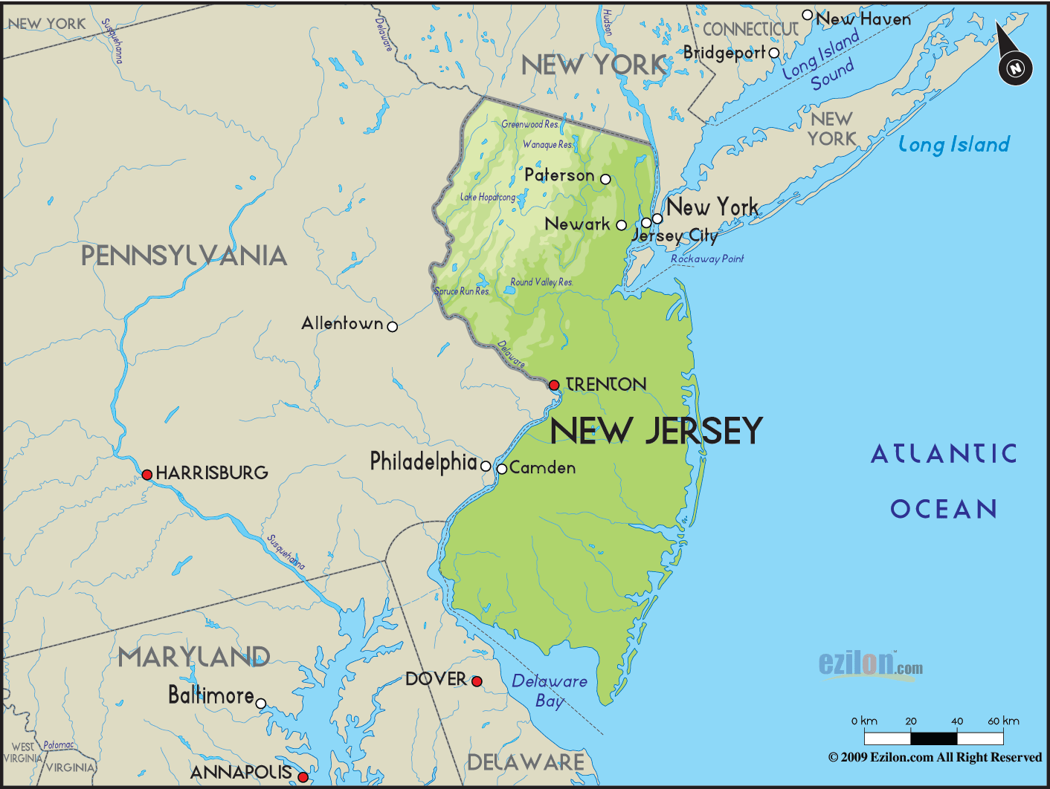

Slide 22
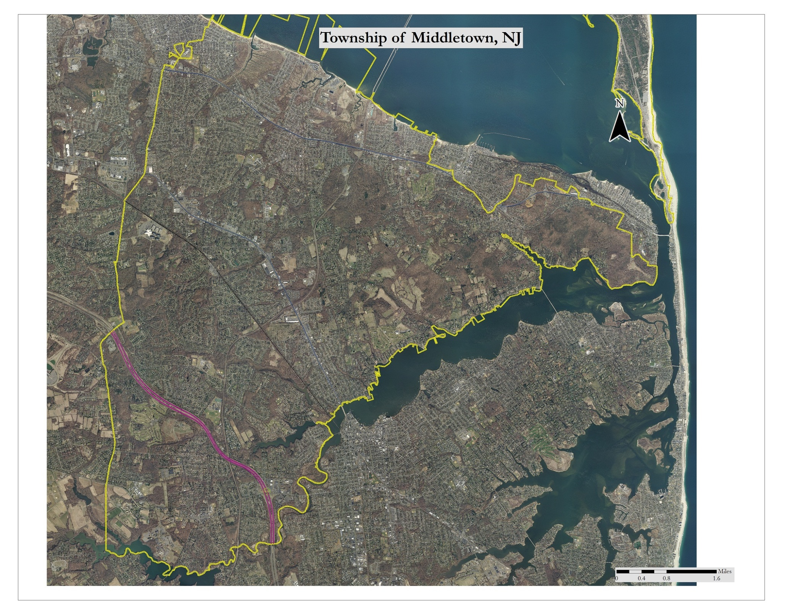

Slide 23
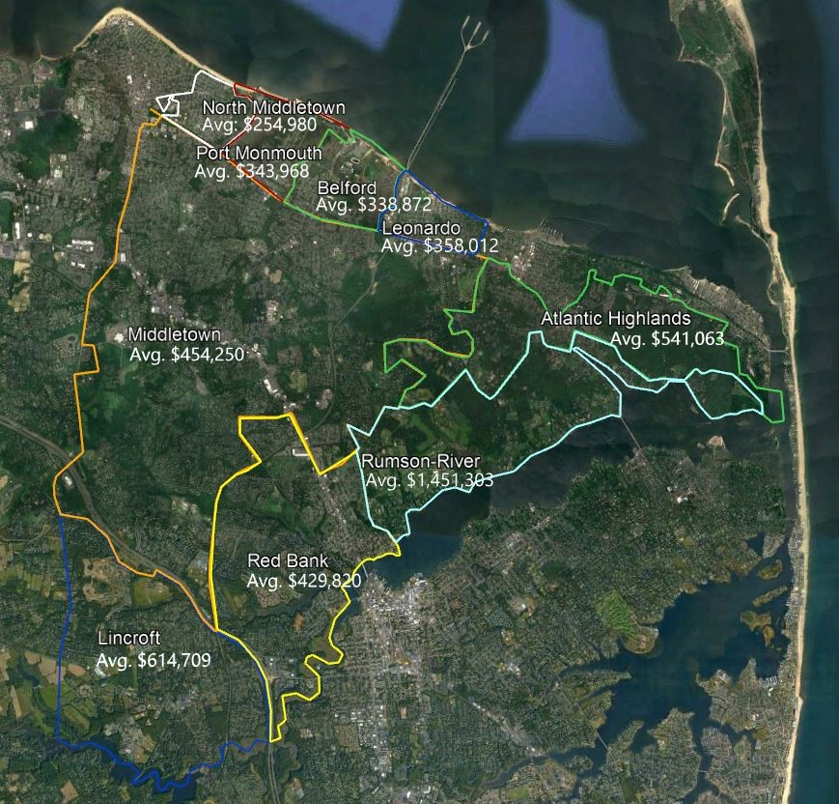
Assessed Values By Neighborhood

Slide 24
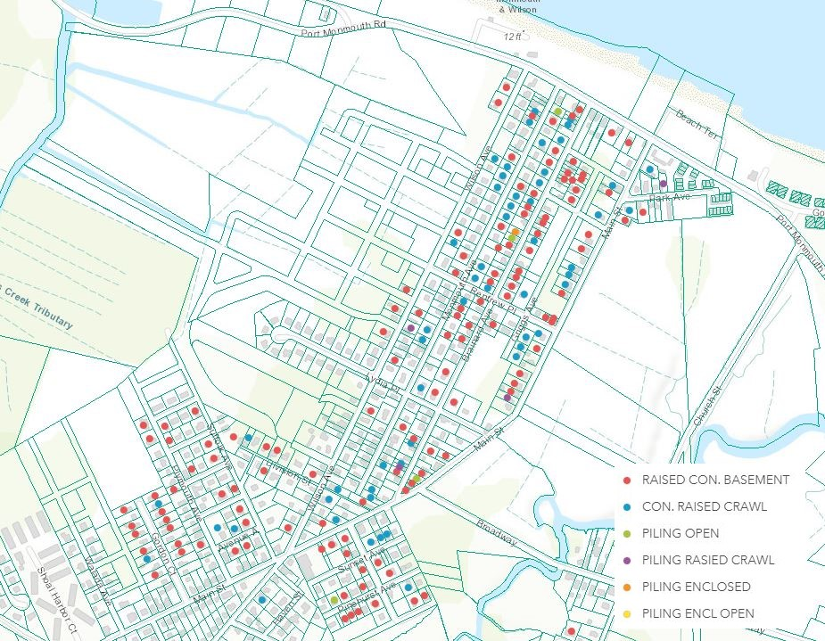
New Foundations – Port Monmouth. More than 50% Have New.

Slide 25
Army Corps of Engineers – Port Monmouth Flood Control Project $130,000,000.00

Slide 26
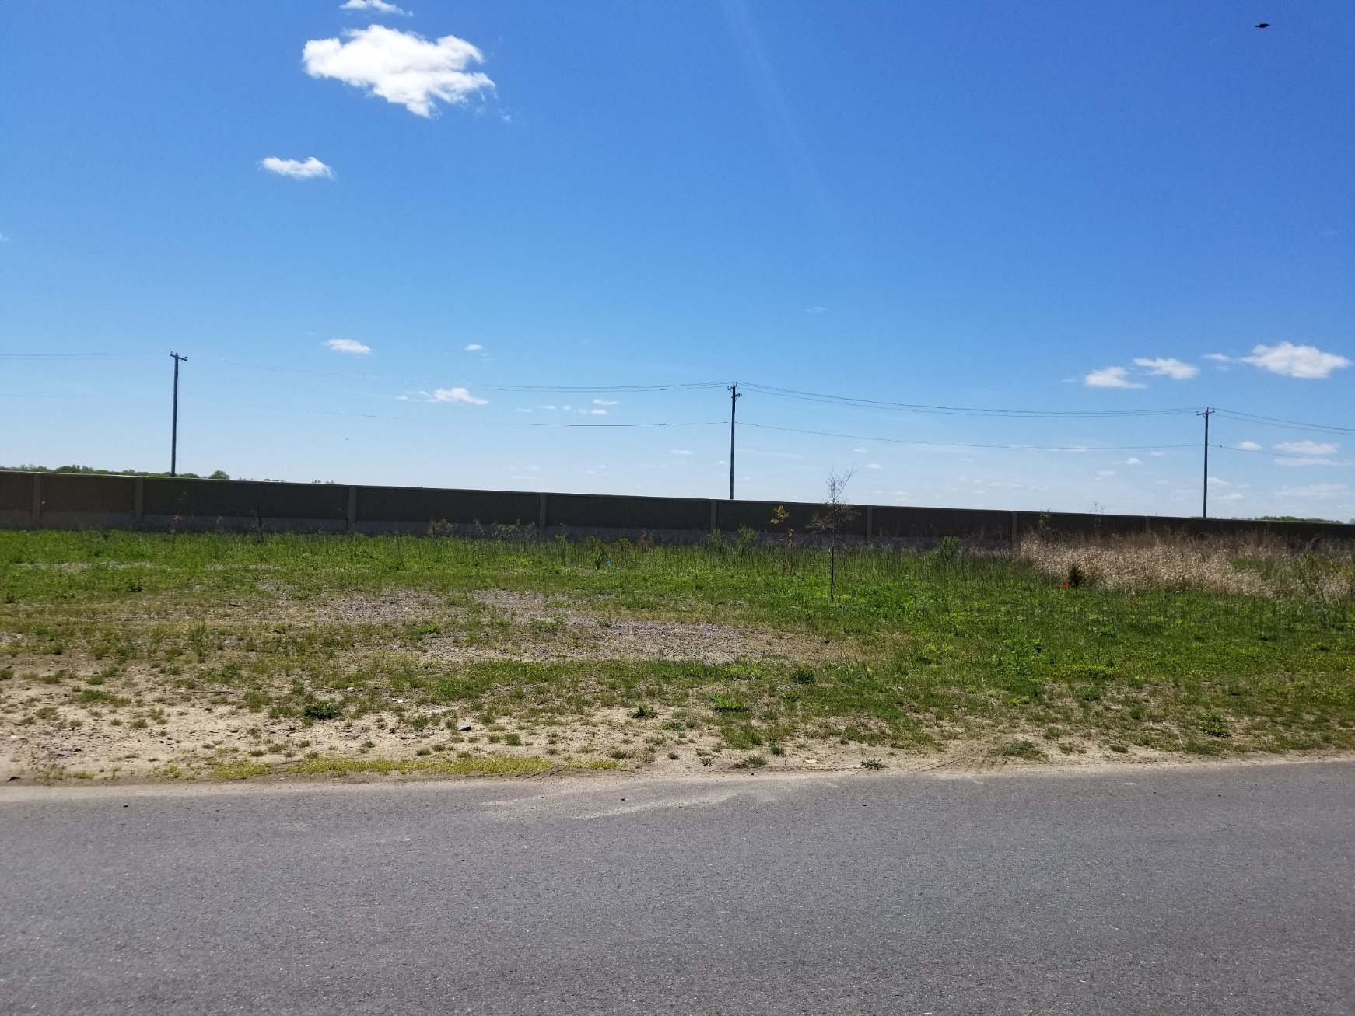
Flood Wall

Slide 27
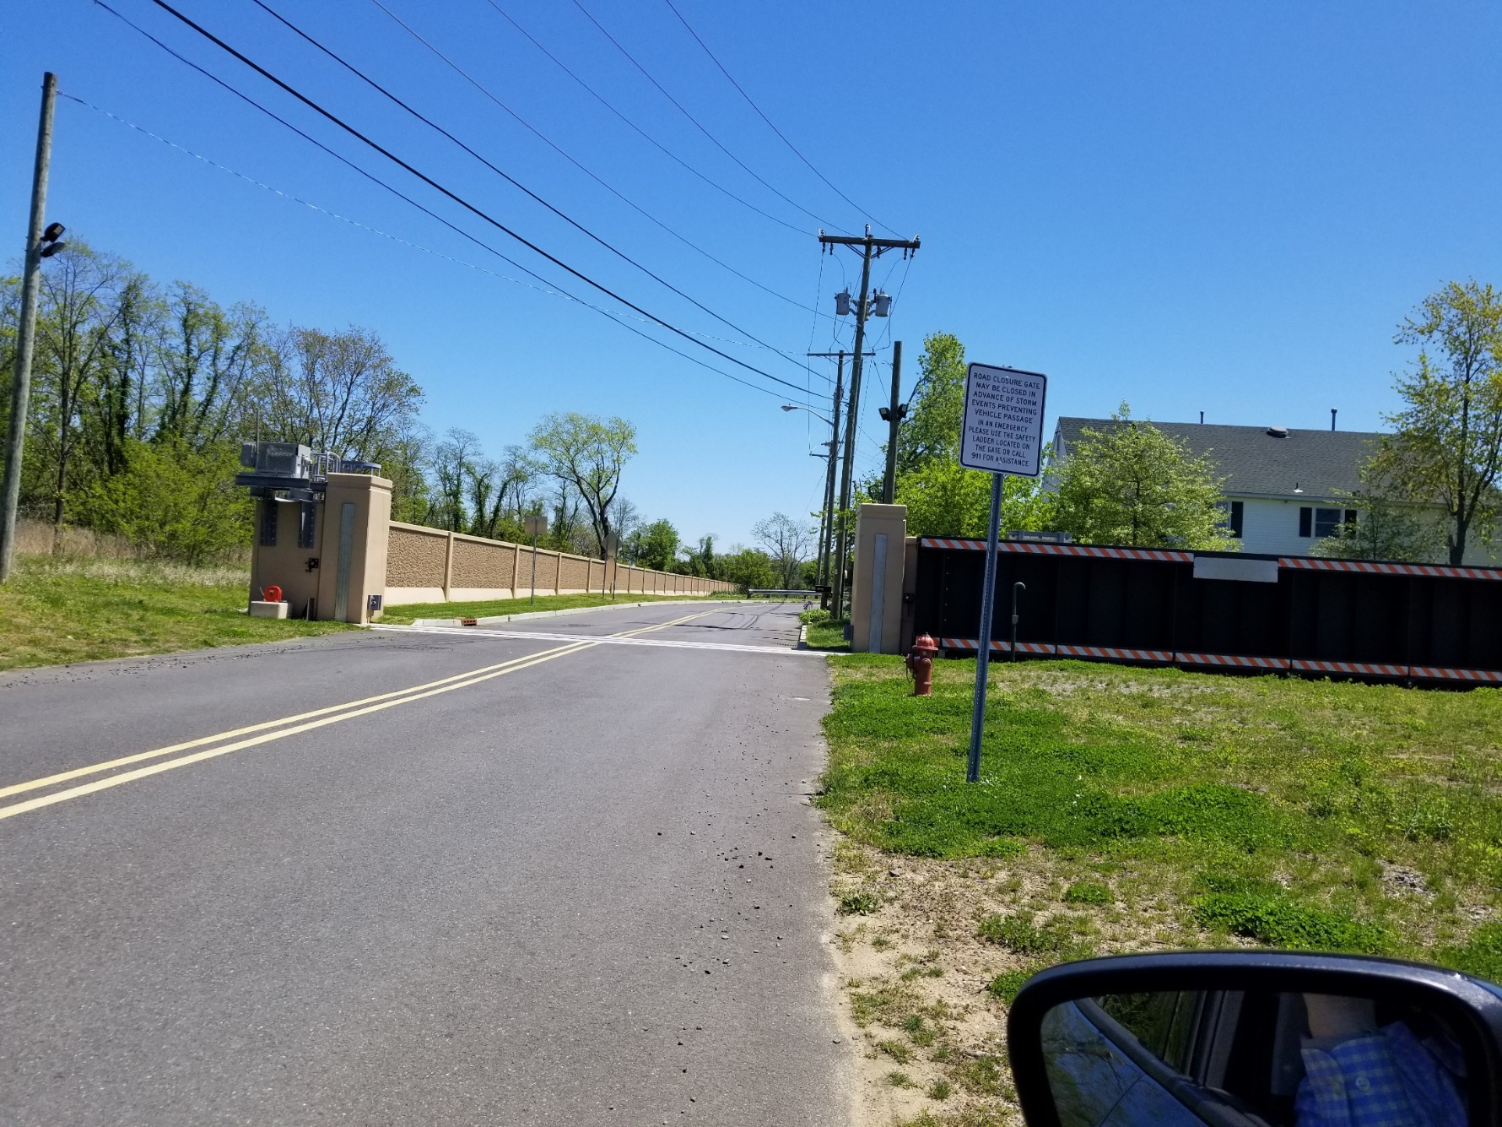
Rolling Flood Gate

Slide 28
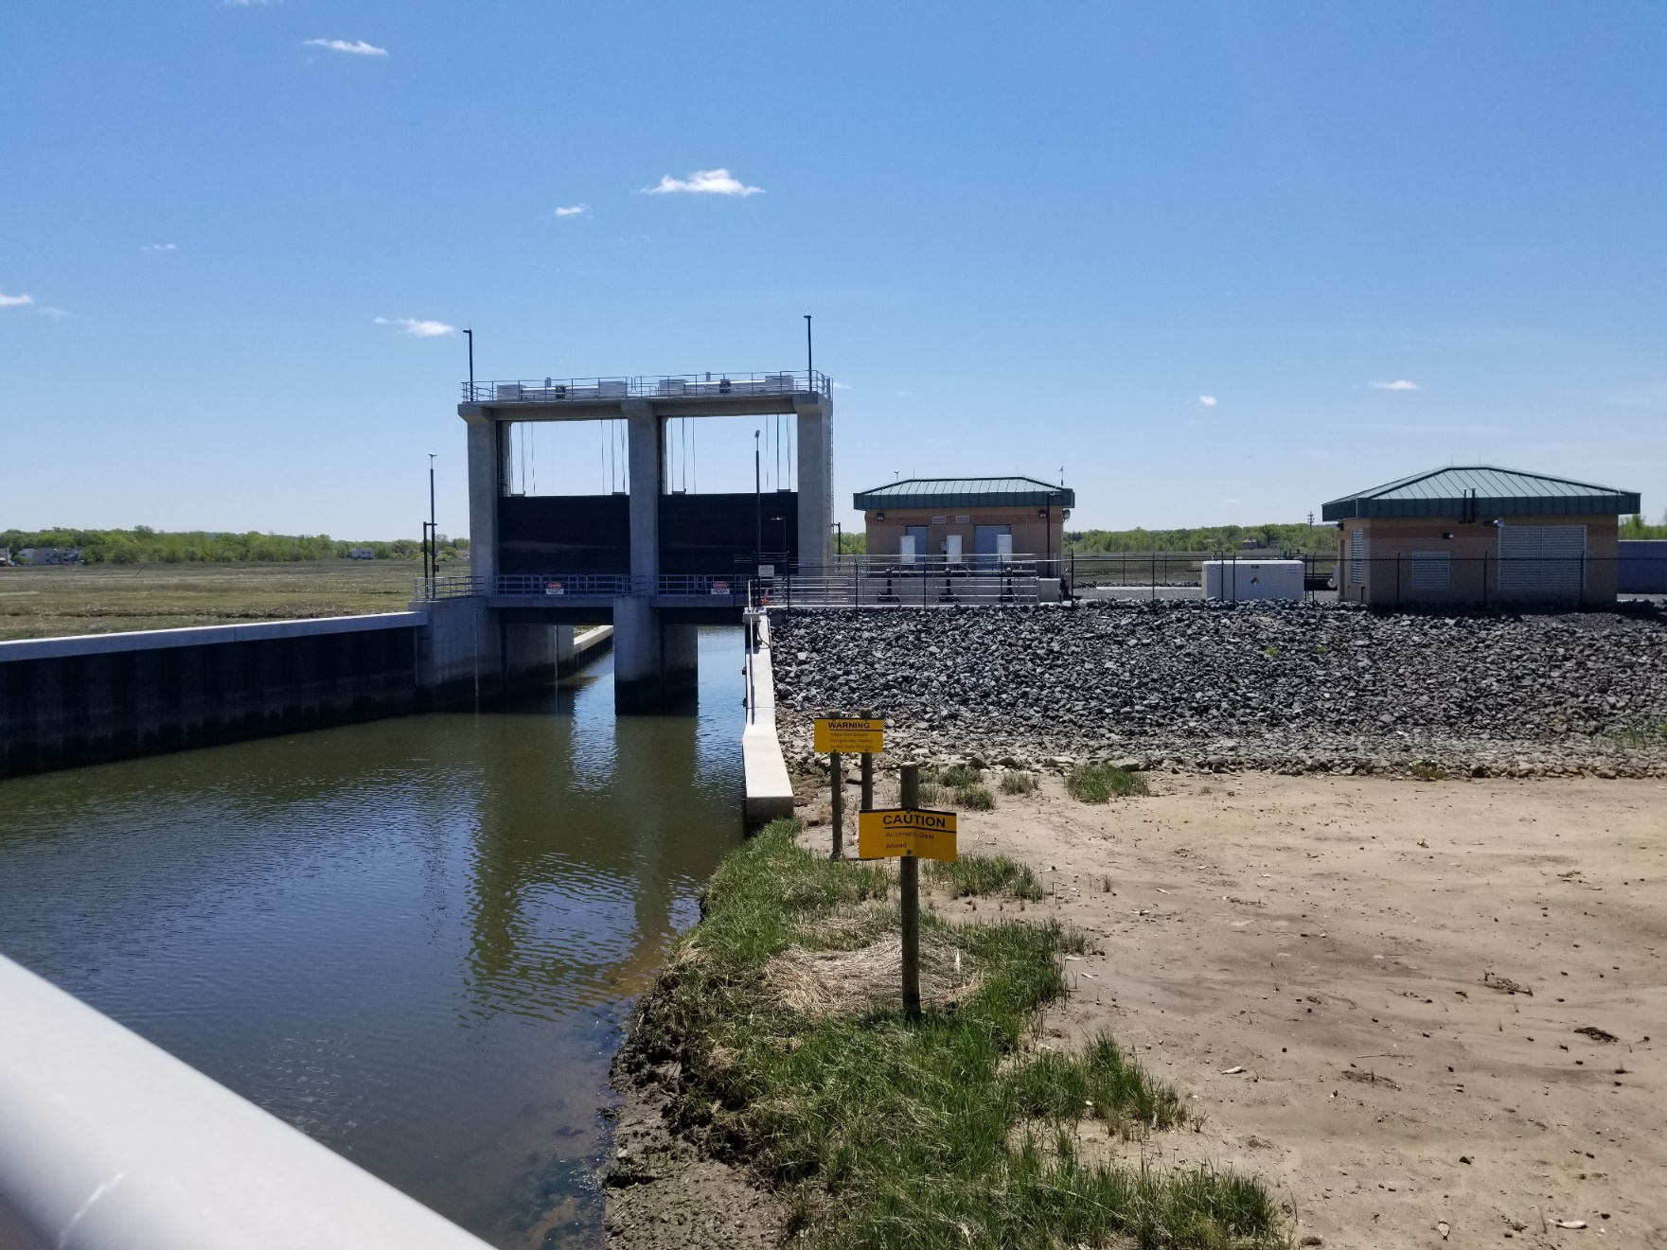
Pump Station and Flood Gates

Slide 29
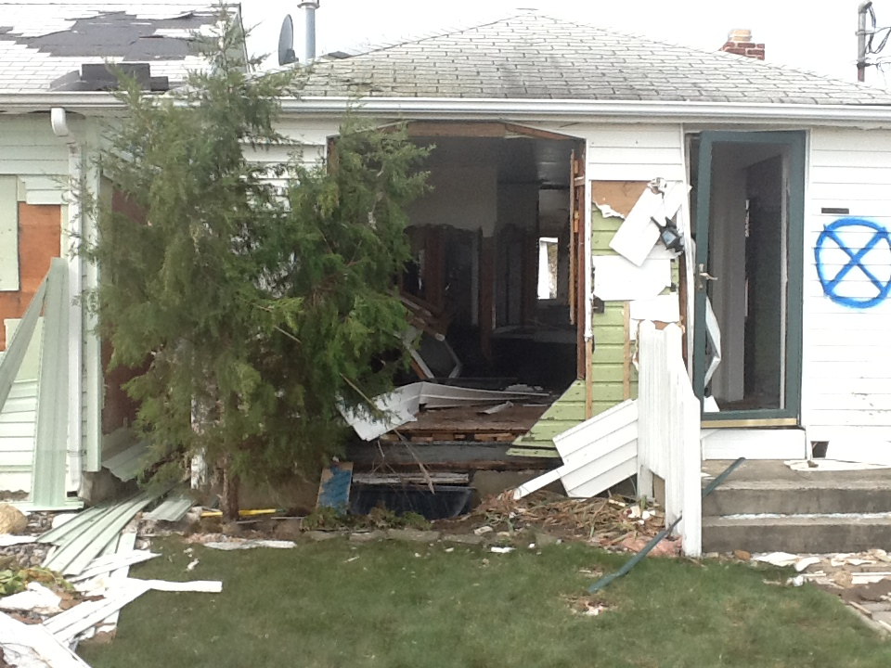
Sandy Damaged Homes

Slide 30
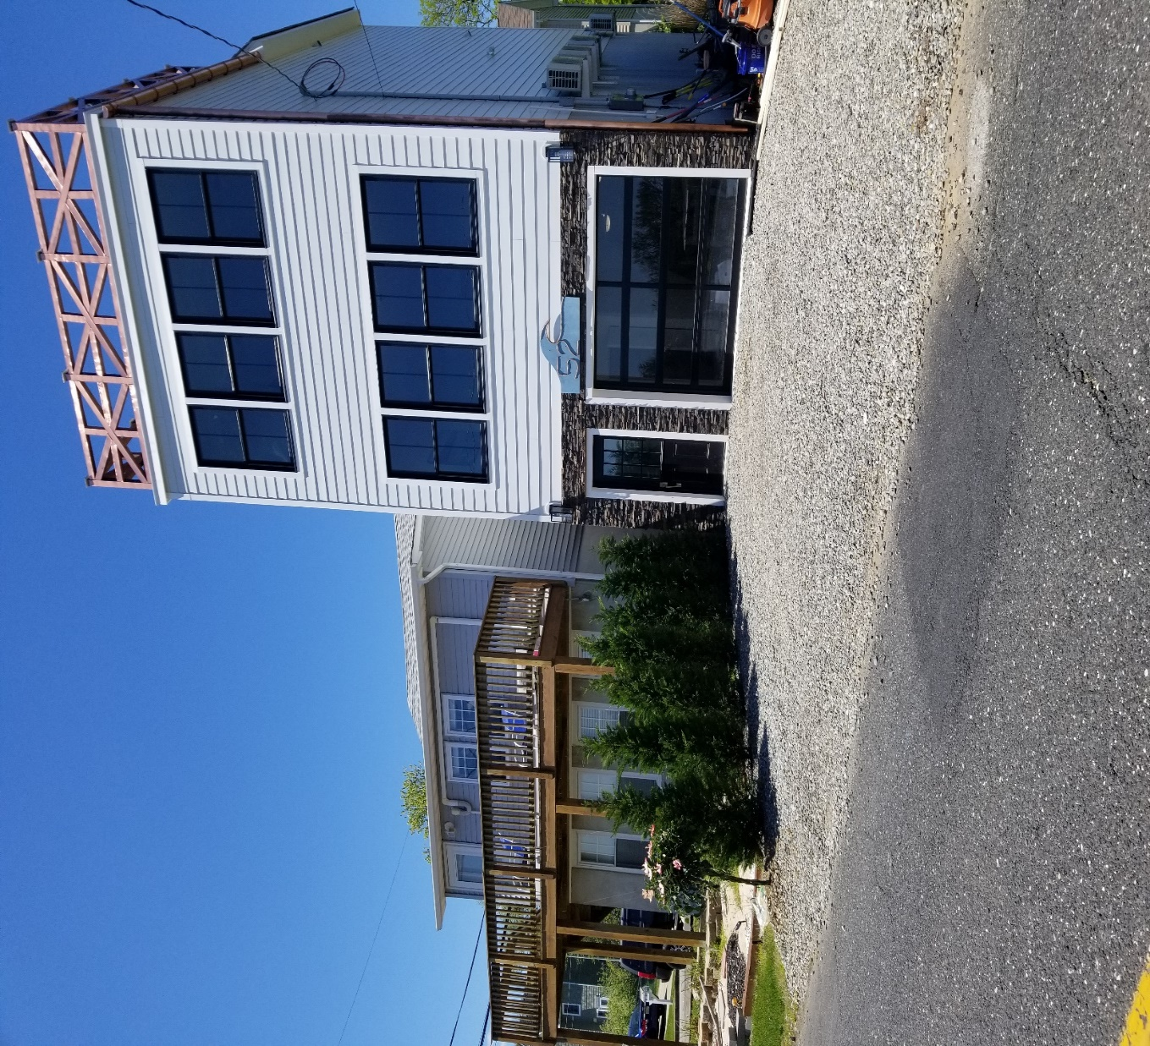
Those Homes Today

Slide 31
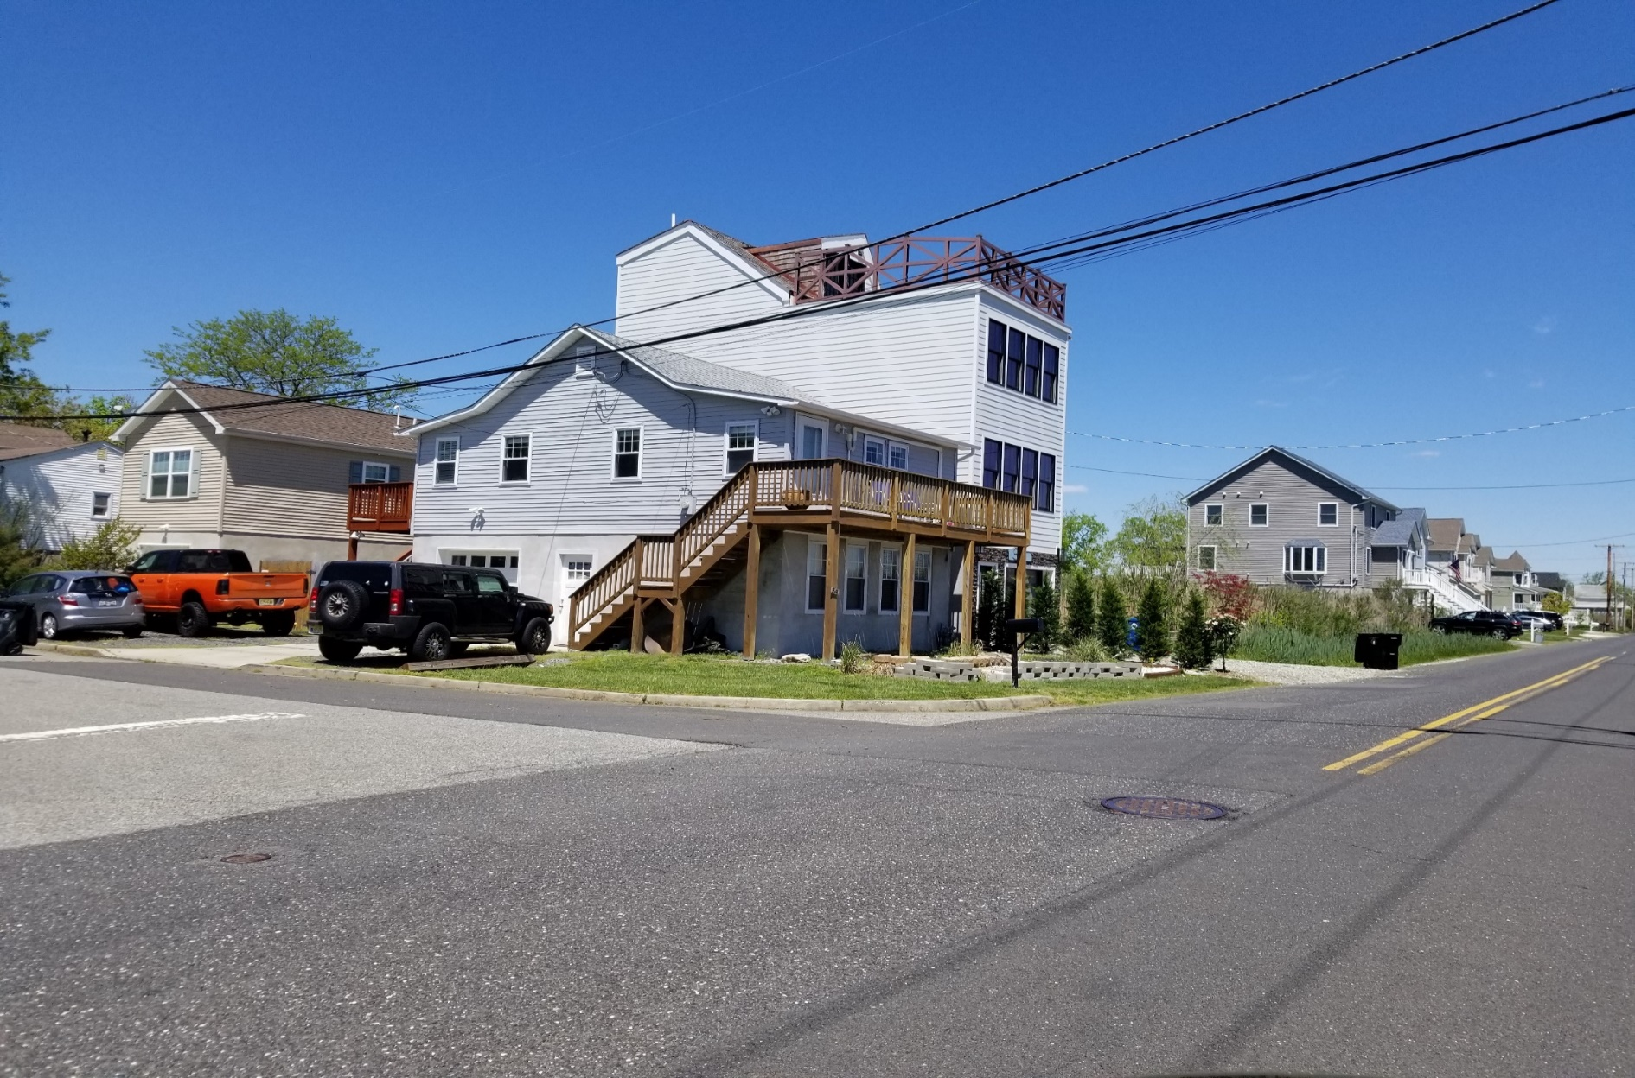
Pre-Sandy Value – Under $100,000.00 Current Value - $425.000.00

Slide 32
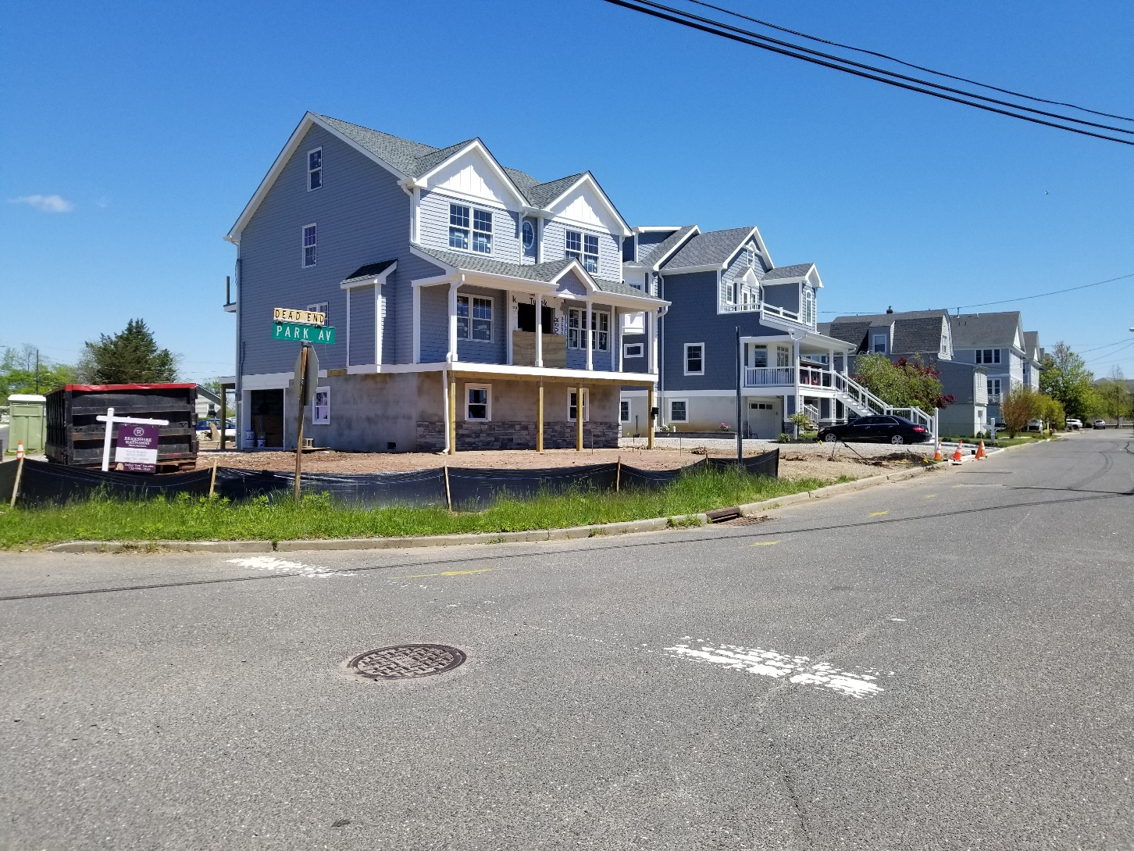
Pre-Sandy Value - $203,000.00 Current Value – Just sold for $770,000.00

Slide 33
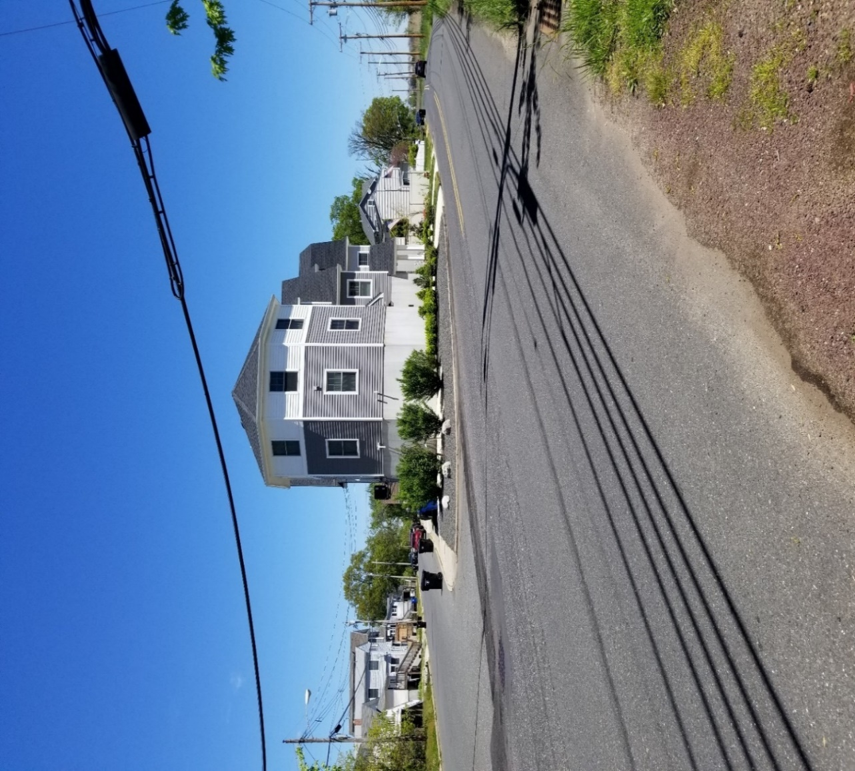
Creativity Pre-Sandy Value - $155,000.00 Current Value - $450,000.00 - $500,000.00

Slide 34
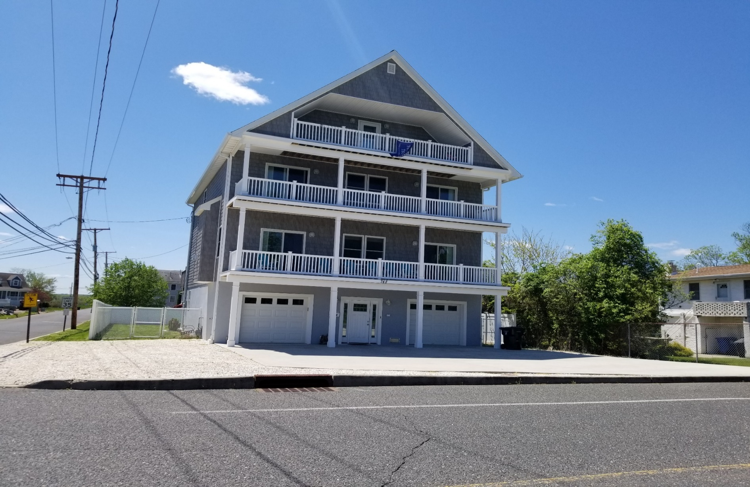
Pre-Sandy Value – Under $100,000.00 Current Value - $771,000.00

Slide 35
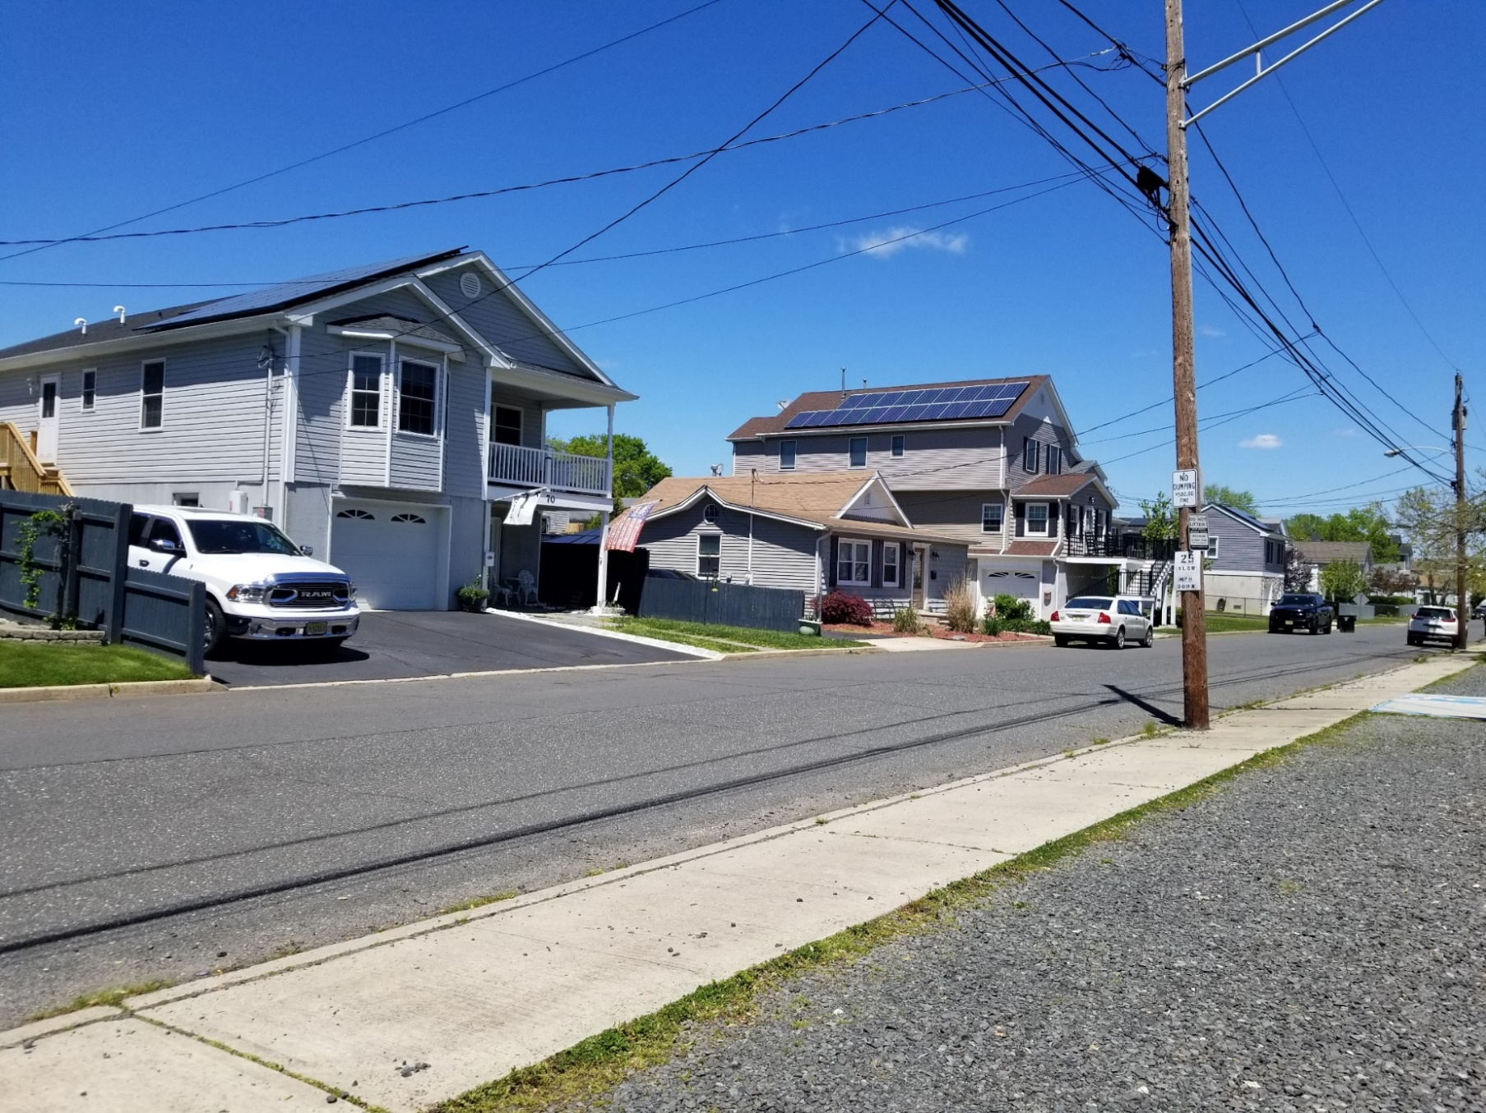
Homes out of Scale

Slide 36
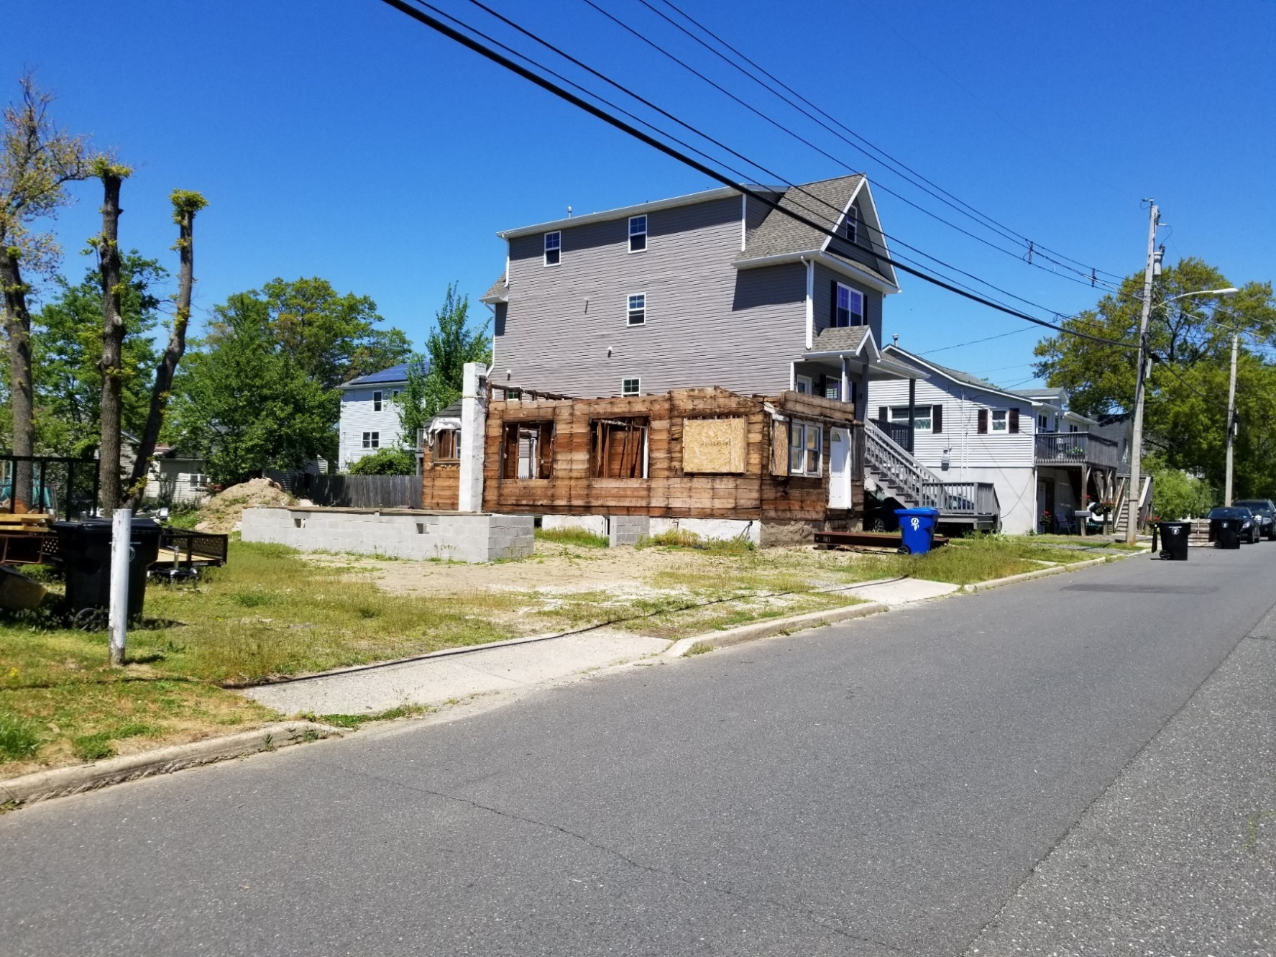
Homes out of Scale

Slide 37
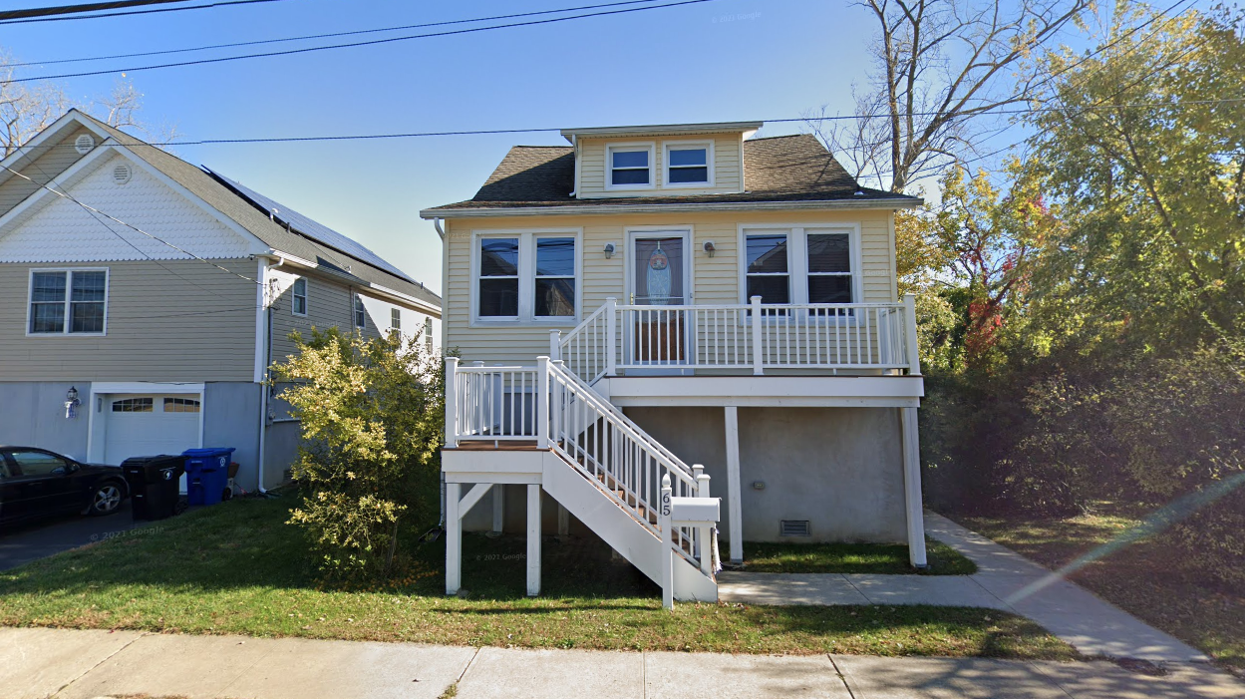

Slide 38
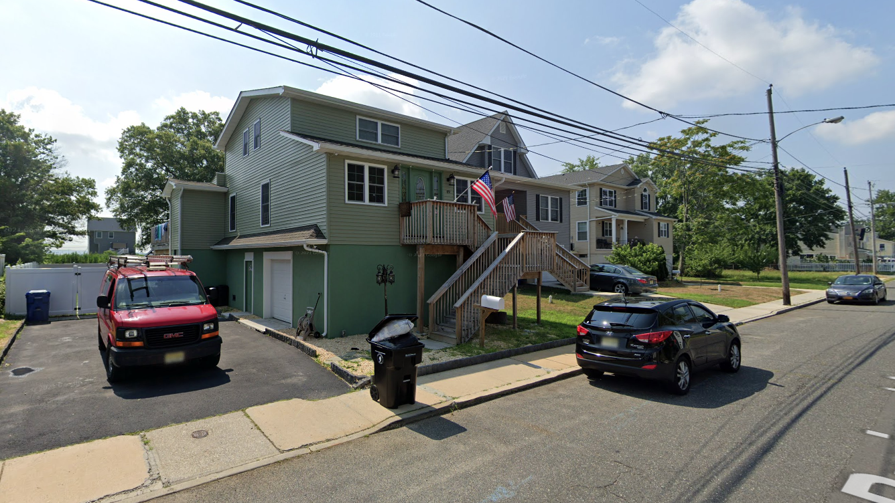

Slide 39
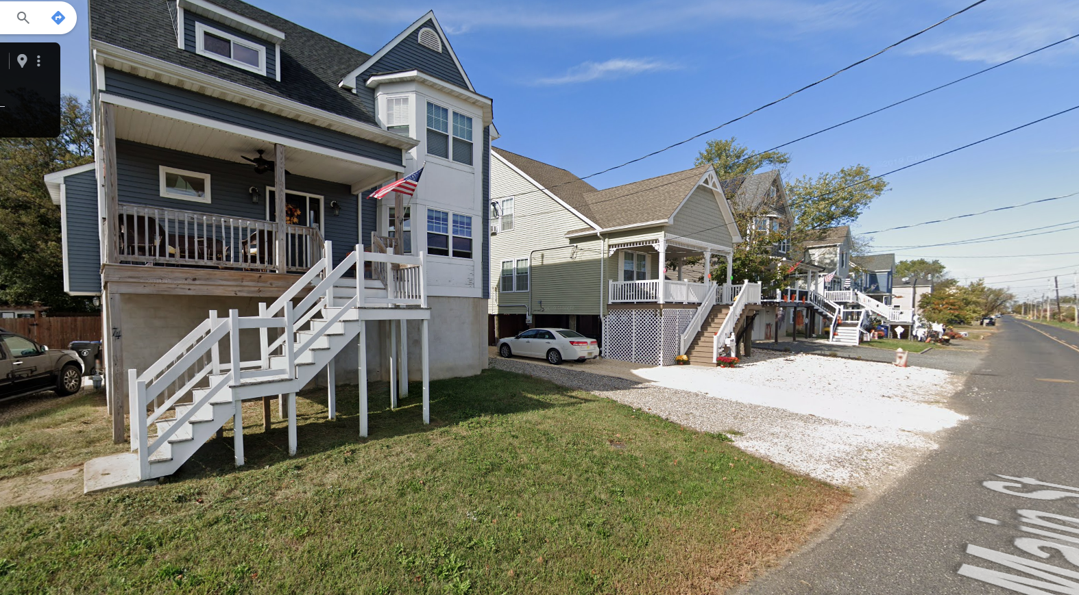

Slide 40
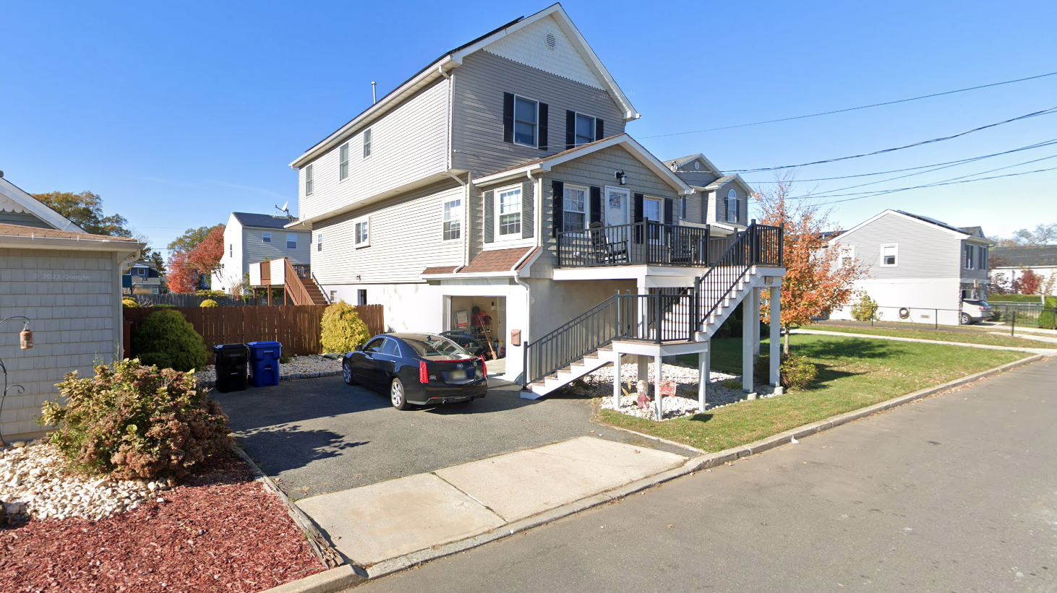

Slide 41

Key Dates & Information
Written comments are due by November 3, 2024. The Department encourages submission of comments electronically at: https://dep.nj.gov/rules/rule-comment-form/. In the alternative, comments may be submitted on paper to:
Melissa Abatemarco, Esq.
Attention: DEP Docket No. 05-24-05
Office of Legal Affairs
New Jersey Department of Environmental Protection
401 East State Street, 7th Floor
Mail Code 401-04L
PO Box 402
Trenton, NJ 08625-0402
NJDEP has indicated their intentions to have the rules adopted an become effective in the Summer of 2025 (June/July).

Slide 42

Contact Us
Mike Cerra: mcerra@njlm.org
Lori Buckelew: lbuckelew@njlm.org
Frank Marshall, Esq.: fmarshall@njlm.org

