Slide 1


State Development and Redevelopment Plan Update
Department of State
Lt. Governor Tahesha Way, Secretary
NJ Business Action Center
Melanie Willoughby, Executive Director
NJ Office of Planning Advocacy
Donna Rendeiro, Executive Director
New Jersey League of Municipalities Lunch and Learn Webinar
October 3, 2023

Slide 2
About the NJ Business Action Center
Mission
To provide exceptional technical assistance, customer service, resources, and information as advocates and mentors for New Jersey businesses and municipalities of all sizes, categories, and diversity.
Vision
We envision a flourishing business community, in which all stakeholders – entrepreneurs, business owners, business leaders, exporters, municipalities, state agencies, elected officials, and organizations – are able to access the vital resources that ultimately strengthen every aspect of doing business in New Jersey.

Slide 3
About the NJ Business Action Center
Provides free, confidential, reliable assistance
-- Office of Business Advocacy – Explore
-- Office of Export Promotion – Expand
-- Office of Small Business Advocacy - Explain
-- Office of State Planning - Enhance
-- Cannabis Training Academy - Educate
Supportive services at every stage of business and land use, regardless of size

Slide 4
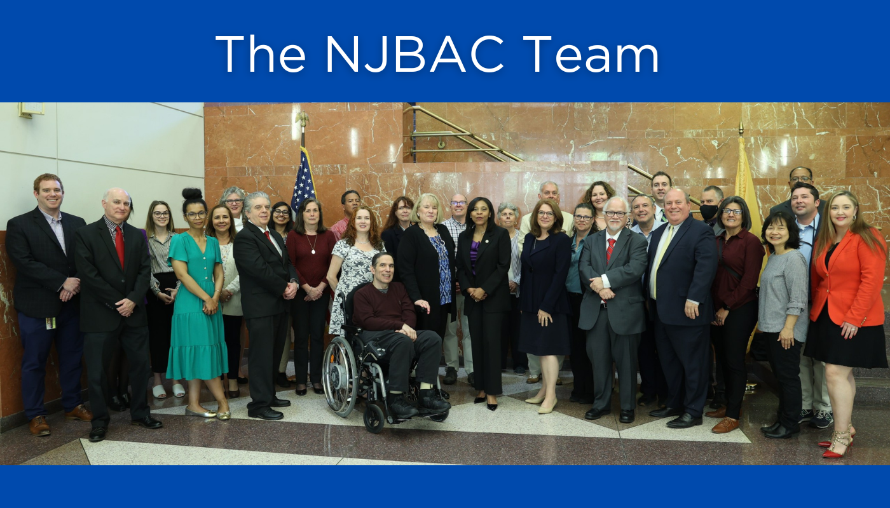

Slide 5

Connecting with NJBAC
Services provided
-- Free of charge
-- Confidentially
-- Quickly, accurately, and carefully
Call: 1-800-JERSEY-7
Chat: business.nj.gov
Learn: state.nj.us/state/bac/
Add Us to Your Favorites

Slide 6
State Development and Redevelopment Plan Update

Slide 7
NJ State Planning Act (NJSA 52:18A-196 et seq)
NJSA 52:18A-200: “The State Development and Redevelopment Plan shall be designed to represent a balance of development and conservation objectives best suited to meet the needs of the State…”:
  Protect the natural resources and qualities of the State…
  Promote development and redevelopment in a manner consistent with sound planning…
  Consider input from State, regional, county, and municipal entities…
  Identify areas for growth, limited growth, agriculture, open space conservation…
  And more….

Slide 8
Process Overview
Four concurrent paths/end products
  Plan Document
  Infrastructure Needs Assessment
  Impact Assessment
  State Plan Policy Map and Mapping Protocol
Constant feedback loops among all four paths as each path further informs the development of the others.
Nevertheless, all four paths can be completed concurrently
Stakeholder engagement is critical
  An early Stakeholder outreach plan
  Required 27 public hearings, per Rules
-

Slide 9
Plan Document
Preliminary Plan – Per NJSA 52:18A-199(a), the Commission “…shall provide a coordinated integrated and comprehensive plan for growth, development, renewal, and conservation of the State and its regions and which shall identify areas for growth, agriculture, open space conservation, and other appropriate designations”.
  The basis for Cross Acceptance
  Early Stakeholder Process
    Not required in the Rules, but critical
Cross Acceptance
  a negotiating process, designed to encourage consistency between municipal, county, regional, and state plans to create a meaningful, up-to-date, and viable State Plan and State Plan Policy Map that is representative of their input and that of the public.
Draft Final Plan
  incorporates the negotiated agreements from the cross-acceptance process. Once the State Planning Commission approves the Draft Final Plan, that document, together with the State Plan Policy Map, becomes the new State Development and Redevelopment Plan

Slide 10
Infrastructure Needs Assessment
Per NJSA 52:18A-199(b), the Commission “shall prepare and adopt as part of the Plan a long-term infrastructure Needs Assessment, which shall provide information on present and prospective conditions, needs and costs with regard to State, county and municipal capital facilities, including water, sewerage, transportation, solid waste, drainage, flood protection, shore protection, and related capital facilities”.
Broken into two phases
  Phase I – Environment, Energy, and Transportation
  Phase II – Affordable Housing, Farmland retention, public recreation, open space land, public recreation facilities, public education, higher education, public libraries, arts, corrections, and human services.
MOU with Rutgers for Phase I; beginning to discuss Phase II; both phases will be consolidated into one report
Must be completed for the Final Draft Plan

Slide 11
Impact Assessment
Per NJAC 5:85-4.7, “…the Commission shall have prepared an assessment of the impacts of the draft Final State Development and Redevelopment Plan relative to the impacts that would likely occur without that draft Final State Development and Redevelopment Plan. The results of the assessment shall identify desirable changes to be incorporated into the Final State Development and Redevelopment Plan.”

Slide 12
State Plan Policy Map
While the State Planning Act does not address the State Plan Policy Map (SPPM or the Map), the rules do.
  A valuable part of the State Plan, the Map is a geographic application of the goals, strategies, and policies of the Plan and is important in interpreting smart growth areas and areas that need protection.
However, the implementation and development of the Map have historically had challenges.
  With input from a diverse set of stakeholders, recommendations on how best to utilize and implement the Official Map of the State Plan must be developed.

Slide 13
State Planning Commission
The SPC is a statutorily mandated Commission with 17 seats made up of public members, state agency representatives, and county and municipal representatives.
The Plan Development Committee
  Made up of some or all of the public and county/municipal members
Ex-officio members to provide input through the interagency workgroup and departmental-specific meetings

Slide 14
Process Improvements
Rule Changes to be adopted on November 7
  Allows for some virtual meetings
  Municipal and County submissions can be received electronically
  Distribution of the Preliminary Plan can be sent electronically
  Municipal master plans and other documentation are no longer required
  Provision of an electronic format for written comments
Procurement of software for recording, tracking, and consolidating public comment
  Publicinput.com/njstateplan

Slide 15
Outreach Plan
Required by the Rules:
  21 public hearings after the Preliminary Plan is published
  6 public hearings after the Final Plan is published
But, that’s not enough and it’s too late in the process, so….
  A listening session at the NJ Planning and Redevelopment Forum
    invited stakeholders provided input into the Plan structure
    several Commissioners were able to listen and respond
    audience members were also able to listen and/or provide written comments.
  Stakeholder webinars (see dates/times/descriptions and register at:
    Publicinput.com/njstateplan (meetings tab)
    Eight held, by topic
    Sessions will be recorded and placed on the website for viewing afterward
  Additional conference sessions and stakeholder engagement opportunities

Slide 16
Outreach Plan, Continued
Dedicated email address for public comments:
  stateplan.comments@sos.nj.gov
  Stateplan.comments@publicinput.com
Call-in number to leave a voicemail comment
  1.855.925.2801, passcode 2813
Interagency Workgroup to facilitate State agency comments
County Planners’ early involvement
  State Planning Subcommittee
  Early discussions on concerns and issues
  Facilitating early informational meetings with counties that request one

Slide 17
Timeline
So many moving parts, and so little time!
  The target completion date is December 2024
    The proposed timeline is an aggressive one, but it is doable.
    Numerous requirements for public notice regarding the notice timeframes are based on scheduled public meetings. For that reason, some later dates are not specific but are estimated by month or quarter.
    As the process moves along, more specificity will be provided when public hearings are scheduled and other variables become more definitive
  The four paths will occur concurrently with constant feedback loops where information, public input, and analyses need to inform other paths.
    In short, coordination and communication are critical.

Slide 18
Timeline, Continued
  Through the end of 2023
    Stakeholder sessions were scheduled, advertised, and convened
    Interagency workgroup meetings are scheduled monthly
    18 County informational meetings held
    Continued conversations with county planners
    Research on population trends
    Complete Preliminary Plan
    Infrastructure Needs Assessment
      Phase I: Develop methodology, State agency and other outreach and initial meetings, literature review, growth scenario assumptions, preliminary assessments sent to State agencies, and receive comments
      Phase II: Execute MOU, kickoff project, begin background research and scoping outreach
    Determine mapping protocols
    Procurement of public comment software

Slide 19
Timeline, Continued
  First half, 2024
    Publish Preliminary Plan and preliminary mapping
    Cross Acceptance
      21 Public Hearings
      Cross Acceptance Reports/Statements of Agreements and Disagreements
      Negotiations
      State Agency Reports and Responses
    Complete INA, Phase I
    Begin, INA, Phase II
    Begin Impact Assessment activities
  Second half, 2024
    Complete INA, Phase II; consolidate into one report
    Incorporate results of Cross Acceptance into the Final Draft
    6 more public hearings
    Produce the Final Draft
    ADOPT!

Slide 20
Implementation
A Plan is only as good as its implementation. Critical to the success of the Plan is working with our State agency partners. The Statute envisions that individual departmental plans be aligned with the State Plan so that a “whole of government” approach is taken.
Further discussion around incentives should be included in our update of the State Plan in recognition that good land use planning has many factors, and the State Plan can be a valuable tool in driving by informing programs and incentives.
There are many opportunities to modernize New Jersey’s land use discussion to ensure that New Jersey remains a great place to live, work, and play. This update gives elected officials at all levels of government the ability to do that.

Slide 21
Thank you!
donna.rendeiro@sos.nj.gov

Slide 22
Questions??? And Thanks!

