Slide 1

New Jersey
Department of
Labor and Workforce Development
Wage and Hour Division

Slide 2

Disclaimer
The presentation is intended as general information only and does not carry the force of legal opinion.
Please note that the law and regulations change quickly.
The New Jersey Statutes and the New Jersey Administrative Code should be consulted for the most accurate and up to date legal information.

Slide 3
Wage and Hour Division
Seasonal Employee & Minimum Wage
Child Labor
Comp Time & Overtime
Earned Sick Leave
Contractor Registration
*New Online Certified Payroll

Slide 4
NEW JERSEY’S MINIMUM WAGE
Date | Most Employers | Seasonal & Small Employers (fewer than 6) | Agricultural Employers | Cash Wage for Tipped Workers | Wage for Long-Term Care Facility Direct Care Staff Members
January 1, 2020 | $11 | $10.30 | $10.30 | $3.13 | $11, $14 as of 11/1/20
January 1, 2021 | $12 | $11.10 | $10.30 | $4.13 | $15
January 1, 2022 | $13 | $11.90 | $11.05 | $5.13 | $16
January 1, 2023 | $14.13 | $12.93 | $12.01 | $5.26 | $17.13
January 1, 2024* | $15.13 | $13.93 | $12.81 | $5.26 | $18.13
*
* The minimum wage rates for 2024 will be at least the amounts listed above, but could be higher based on the Consumer Price Index (CPI).
MW-570 (1/23)
Notes:
Employers must pay New Jersey Minimum Wage or any higher rate of pay agreed upon at time of hiring
Employers must pay New Jersey Minimum Wage or any higher rate of pay agreed upon at time of hiring

Slide 5

Minimum Wage – Seasonal Employer
Three Ways:
1. Services provided only in 10-week period during June, July, August and September
2. Previous calendar year: at least 2/3 of gross receipts received in continuous 16-week period
3. Previous calendar year: at least 75% of wages paid were for work performed during single calendar quarter
Doesn’t include labor on a farm
2023 minimum wage: $12.93/hour
Date
January 1, 2020
January 1, 2021
January 1, 2022
January 1, 2023
January 1, 2024*
Seasonal & Small Employers (fewer than 6)
$10.30
$11.10
$11.90
$12.93
$13.93
Notes:
Seasonal employer” means an employer who exclusively provides its services in a continuous period of not more than ten weeks during the months of June, July, August, and September, or an employer for which, during the immediately previous calendar year, not less than two thirds of the employer’s gross receipts were received in a continuous period of not more than sixteen weeks or for which not less than 75 percent of the wages paid by the employer during the immediately preceding year were paid for work performed during a single calendar quarter.
“Seasonal employment” means employment during a year by an employer that is a seasonal employer, or employment by a non-profit or government entity of an individual who is not employed by that employer outside of the period of that year commencing on May 1 and ending September 30, or employment by a governmental entity in a recreational program or service during the period commencing on May 1 and ending September 30, except that “seasonal employment” does not include employment of employees engaged to labor on a farm on either a piece-rate or regular hourly rate basis.

Slide 7
Work that Minors Can’t Do
Construction sites, until age 18
Any adult-type entertainment, until age 18
Poisonous acids, dyes or chemicals, until age 18
Establishments serving alcohol, until age 16
Lifeguards, until age 15*
‘Cooking’, until age 16*
Power tools, until age 16
Factory work, until age 16
Deli-slicers, until age 18
Trash compactors, until age 18
Any work on roofs*
Notes:
On 2/14/2005 Federal provisions and HAZARDOUS ORDERS were Updated and there are restrictions of Work that Minors Cannot Do:
If a Fourteen- and 15-year-old wants to work for McDonalds they may cook only with electric or gas grills, or automated deep fryers.
Minors working in an office at a Construction site they have to be – more than 30 feet from site.
Minors who are 14 -17 years old are permitted to work as volunteers for nonprofit organizations such as Habitat for Humanity
Commissioner of Labor has specific restrictions that No Minor shall:
operate, perform maintenance, clean, inspect or work in, about, or in connection with any power-driven machinery
work without the safety equipment required by law
be exposed to hazardous waste products or other hazardous substances
no minor shall be permitted to work on any excavation, scaffolding or roofing;
For more information refer to the Child Labor Laws & Regulations number 12:58-3.1 through 4.6 in the Blue Book Pages 22 &23
Lifeguards (as per USDOL, not NJ Child Labor Laws)
Fifteen-year-olds, but not youth less than 15 years of age, may be employed as lifeguards at traditional swimming pools and most facilities of water amusement parks. Such employment must meet the following conditions:
The 15-year-old must be trained and certified by the American Red Cross, or a similar certifying organization, in aquatics and water safety; and
The 15-year-old must be employed in compliance with all the other applicable provisions of the federal child labor rules contained in Child Labor Regulations No. 3 (see Subpart C of 29 CFR Part 570), , including the restrictions on the hours and times of day that 15-year-olds may be employed as discussed below; and
The federal child labor rules require that 15-year-olds who are employed to teach or assist in teaching others how to swim must also be certified as swimming instructors by the American Red Cross or some other similar certifying agency.
Emphasize the “written parental permission” and that this only applies to summer period “ during the period beginning on the last day of a minor's school year and ending on Labor Day of each year until 9 p.m. of any day with written permission from a parent or legal guardian.”
FOR 16 TO 17 YEAR OLDS
minors between 16 and 18 years of age may be employed after 11 p.m. during any regular vacation season, and on days which do not precede a regularly scheduled school day, with a special written permit from their parents or legal guardian stating the hours they are permitted to work; provided that minors between 16 and 18 years of age may be employed in a seasonal amusement or restaurant occupation after 11 p.m. and following 12:01 a.m. of the next day, if that employment is a continuation of a workday which began before 11 p.m., either during any regular school vacation season, or on workdays which do not begin on a day which precedes a regularly scheduled school day, with a special written permit from their parents or legal guardian stating the hours they are permitted to work, except that in no case shall minors between 16 and 18 years of age be employed after 3 a.m. or before 6 a.m. on a day which precedes a regularly scheduled school day
g) "Restaurant" means any establishment or business primarily engaged in the preparation and serving of meals or refreshments, both food and drink, and shall include but not be limited to the following: dining establishments, catering establishments, industrial caterers, and drive-in restaurants.
"Seasonal amusement" means any exclusively recreational or amusement establishment or business which does not operate more than seven months in any calendar year or which has received during any consecutive six months of the preceding calendar year average receipts equal to or less than 33 1/3 percent of its average receipts for the other six months of that year. "Seasonal amusement" includes but is not limited to amusement rides and amusement device ticket sales, and operations of games. However, "seasonal amusement" does not include retail, eating or drinking concessions, camps, beach and swimming facilities, movie theatres, theatrical productions, athletic events, professional entertainment, pool and billiard parlors, circuses and outdoor shows, sport activities or centers, country club athletic facilities, bowling alleys, race tracks and like facilities which are not part of a diversified amusement enterprise.

Slide 8
New Process for Working Papers
Teenagers and employers each go to MyWorkingPapers.nj.gov to get started.
Employers receive a unique 8-digit code when they register, which they share with every minor they hire.
The minor completes the online working papers application, entering their caregiver’s name and email address, and the employer’s 8-digit code, which links the application to a specific employer.
Emails prompt the employer and caregiver to complete their portions of the application and sign off.
The minor begins working when their application is approved by NJDOL.

Slide 9
Earned Sick Leave is the Law in New Jersey
NJ Stat. § 34:11D-2
All full-time, part-time, and temporary workers all eligible.
Note: Public employees who are provided with sick leave at full pay under any other NJ law or rule are exempt.
If you have an existing sick leave policy for employees, it must meet or exceed the requirements of the law.
Employees can use sick time to care for themselves or family member – definition of family is generous:
for physical/mental illness or wellness care
to cope with domestic or sexual violence
to attend a meeting at a child’s school
Employees can earn 1 hour of sick leave for every 30 hours worked, up to 40 hours per benefit year. Or employers can employees with 40 hours of leave up front each year.
Notes:
Questions:
By email: Send a message to wage.hour@dol.nj.gov
By phone: Call 609-292-2305 between 8:30 a.m. and 4 p.m. TTY users can contact this department through NJ Relay: 7-1-1
Printable faqs: whatemployersneedtoknow.pdf (nj.gov)

Slide 10
Earned Sick Leave Requirements for Employers
An employer may require 7 days advance notice when an employee has planned to use sick leave (Ex: doctor’s appointment for wellness care).
If an employee’s need for earned sick leave cannot be planned, an employer may require the employee to give notice as soon as it is practical. (Ex: waking up with a fever).
Employers can require reasonable documentation if an employee uses earned sick leave on 3 or more consecutive workdays, or on certain dates specified by the employer.
Employers cannot retaliate against employees for requesting or using earned sick leave.
Learn more at mysickdays.nj.gov​
Notes:
If an employee knows they are going to need sick leave in advance – for example for an appointment – the employer can require up to 7 days advance notice
But if they can’t plan the need for sick leave – like a child wakes up sick and they cannot go to work because they must stay home with them – the employer can only require the employee to provide notice as soon as they possibly can.
See webpage for printable handouts in English and Spanish and additional languages!

Slide 11
Contractor
Registration
The Public Works Contractor Registration Act (N.J.S.A. 34:11-56.48 et seq.) requires contractors to register with the New Jersey Department of Labor and Workforce Development prior to bidding on or engaging in public works.

Slide 12
Contractor Registration
Subcontractors named in a bid must be registered at the time the bid is submitted.
All other subcontractors must be registered at the time they are hired (the time that the subcontract agreement is signed).
If a contractor bids on or is found working on a public works project without being registered, the max penalty for a first violation is $2500 and a Stop Work Order may be issued.

Slide 13
Registered Public Works Contractor List How do I Confirm Contractor Status?
NJDOL maintains a list of registered public works contractors on our website.
The current list contains more than 6,000 businesses, and is searchable by name, address, registration date, and certificate number.
For specific and current registration information status, please contact the Wage and Hour Division at pwcr@dol.nj.gov , or 609-292-9464.
Online: Go to our website: njportal.com/lwd/pwcr.
Contractors can also check the status of their application when they apply online.
Notes:
The PW Contractor list should be consulted by any government agency or entity before hiring for a public works job. Doing so can help avoid unnecessary project delays and extra costs to businesses, schools, government entities and taxpayers.

Slide 14
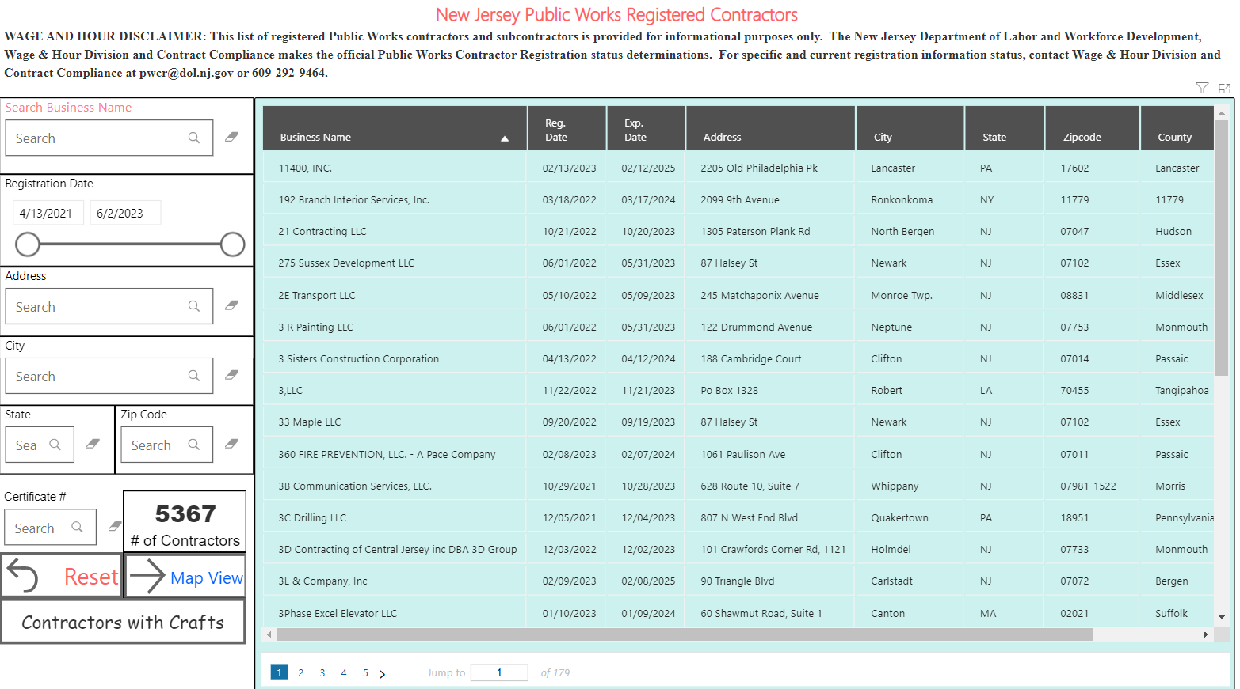

Slide 15

Overview of Contractor/Subcontractor Responsibilities
Contractors and subcontractors must:
Register with the Department of Labor and Workforce Development., Wage and Hour Division
Pay prevailing wage rates based upon work classifications for all hours.
Post a wage determination in a prominent place where workers have access.
Submit certified payroll records to the public body within 10 days of payment of wages.
Produce in-house payroll and any other related records to the Department of Labor within reasonable timeframe.

Slide 16
The New Jersey Prevailing Wage Act (N.J.S.A. 34:11-56.25 et seq.)
Public Policy:
“It is declared to be the public policy of this State to establish a prevailing wage level for workmen engaged in public works in order to safeguard their efficiency and general well-being and to protect them as well as their employers from the effects of serious and unfair competition resulting from wage levels detrimental to efficiency and well-being"

Slide 17
Overview
The Public Contract Section of the Wage and Hour Division regulates the payment of prevailing wage rates on public work projects through:
The distribution of a prevailing wage rate determination for each trade, craft and classification;
Implementation of fines and penalties to employers; and
Debarment from bidding or working on public works projects for three years for contractors determined to be serious offenders.
Stop Work Orders immediately halt work at any public or private work site – both construction and non-construction sites – when an initial investigation finds evidence that the employer has violated any state wage, benefit, or tax laws

Slide 18
Additional Responsibilities
Public work contracts must contain language advising of the Prevailing Wage Act and the Public Works Contractor Registration Act.
When the public body receives a bid for a contract which is 10% or more lower than the next lowest bid, the lowest bidder must submit a written certification to the public body prior to awarding the contract and certifying the prevailing wage rate.
If the contractor does not provide this required certification, then the public body must award the contract to the next lowest responsible and responsive bidder.

Slide 19
Certified Payroll
- Contractors must submit Certified Payrolls to the public body for every pay period worked and will soon be required to do so electronically
Submitting them to a general contractor does not satisfy the legal requirements.

Slide 20

N.J.A.C. 12:60-5.1(c)
The public works contractors and subcontractors shall submit to the public body or lessor which contracted for the public works project the following in a form satisfactory to the Commissioner.
1. A certified payroll record on each public works project.
i. Such record shall be submitted each payroll period within 10
days of the payment of wages.
ii. The public body shall receive, file, store and make available
for inspection at its normal place of business and during
normal business hours the certified payroll records.

Slide 21
NEW !
ONLINE
Payroll Certification
P.L.1963, c.150 and P.L.1999, c.238.
Voluntary for Public Bodies
Modernization to be VENDOR & PUBLIC BODY – FRIENDLY

Slide 22





What RIPL Brings
RIPL integrates three key areas of expertise into a holistic approach to government innovation.
Policy
Thought leaders in policy innovation, implementation, and operationalization of public programs through modernized public sector technology
“Our partnership with RIPL helps use objective research and data at high speed so we can be innovative and help people in need. RIPL’s approach to data and science for social good could benefit local and state government throughout the country.”
RIPL
Science
Tech
Design and build scientific-grade solutions to conduct policy-conscious research and analysis of public programs
Productionize science into scalable technology resources and services accessed through customer-focused user interfaces
Eric J. Beane,
former Secretary of Health and Human Services, State of Rhode Island
Notes:
Abby
Tech for social impact non-profit. we have well-rounded expertise to deliver tech-based policy solutions so that we can bring technology that the private sector uses to the public sector a speed that public sector usually can’t do alone, in order to help governments better solve policy problems using their own data.
Policy – come with expertise around how governments function so that we can effectively partner; have policy expertise in public finance, workforce development, postsecondary education, labor etc.
Tech – we have both front and back end developers dedicated to creating solutions that meet partners’ needs; our solutions rest on cloud-based infrastructure that is both flexible and scalable.
Science – world class economists and data scientists who help deliver machine learning and analytics; embed analytics into our solutions.

Slide 23
Project Goals
Use cloud technology to create an application where public works contractors across the state can digitally submit certified payrolls so that information is:
Easily searchable
Able to be analyzed and reported upon
Made readily available to the state for its enforcement responsibilities and to other stakeholders as needed
Develop analytical and reporting protocols needed to carry out strategic enforcement functions and provide greater transparency to the public on the behavior of employers under contract to the state.
Notes:
Ultimately – want to make it easy for everyone to comply with laws; easy data submission and tools to use data.

Slide 24

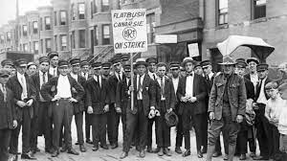


Our Solution: Modernize Tools for Compliance & Enforcement
Public Portal
Improve transparency and access to compliance information
Internal NJDOL Portal
Get a birds' eye view of data and analytics for enforcement
Approved data for public consumption
Public Body Portal
Contractor info
Contractor Portal
Upload contracts, views certified payroll
Submit certified payroll (*and optionally contracts)
Contract info
Confidential – not for citation or circulation
Notes:
Internal portal – also connecting existing administrative data for insights/analytics
Certified payrolls – variety of formats to make it extremely user friendly
Information in public portal – help improve transparency AND cut down on time NJDOL spends responding to inquiries and requests so they can focus on enforcement.
The public body piece may be unique to NJ, but this technology is customizable.
What we're about to show you is our first release – a minimum lovable product – and as soon as we launch this, we are diving right back into discovery, user testing, & prioritization with the project team to make sure the next versions meet their needs for new features and functionality.

Slide 25
New Jersey Wage Hub Timeline
Soft Launch & User Testing
Wide Release (General Availability)
Iterative Development
May 2023 – June 2023
Discovery & Planning
Build MVP Application
September 2022-January 2023
January 2023 – May 2023
Notes:
Agile, iterative process

Slide 26
Begin Using the New Jersey Wage Hub Today!
Register for the New Jersey Wage Hub:
Create an account at https://njwages.nj.gov
Note: multiple individuals at each municipality can create accounts.
Add any active public works contracts
Invite your prime contractors to begin using the application
If you have questions, please review the user guide or reach out to njwagehubinfo@dol.nj.gov.
Notes:
Agile, iterative process

Slide 27
THANK YOU!
QUESTIONS?
New Jersey Department of Labor and Workforce Development
Wage and Hour Division
P.O. Box 389
Trenton NJ 08625-0389
Contact us: http://www.nj.gov/labor

